Slide 1


Using Assistive Technology in Exams and Assessments
Dr Abi James
BDA New Technologies Committee
University of Southampton

Slide 2
Assistive technology use in exams:
Duty of awarding bodies to make reasonable adjustments to assessment arrangements under the Equality Act 2010
Access arrangements are the principal way in which awarding bodies comply with the duty
Applications for GCSE and A-Levels managed by JCQ through Access Arrangements online
Functional skills qualifications: must go through qualification provider

Slide 3
Assistive technology use in exams
Awarding body must consider if an adjustment is reasonable - depends on a number of factors
The candidate
Its suitability for that assessment
The assessment criteria
If unsure ask!
Very few adjustments are specifically prohibited under Section 96 Equality Act

Slide 4
Assistive technology use in exams:
Enables candidates to demonstrate their skills independently
Candidates report higher self esteem & being less self conscious
Assistive Technology often offers a more cost-effective & scalable access arrangement for a centre.
Notes:
The duty for an awarding body to make a reasonable adjustment will apply where assessment arrangements would put a disabled candidate at a substantial disadvantage in comparison with a candidate who is not disabled. In such circumstances, the awarding body is required to take reasonable steps to avoid that disadvantage. These reasonable adjustments are provided through the Access Arrangements.

Slide 5
Introduce technology as early as possible & plan
The adjustment must be a candidates usual way of working but candidates should be competent with the technology
Form 8s must have evidence of “normal way of working” for the adjustment, but doesn’t need to be technology specific or used all the time e.g.
Support in the classroom from staff or peers
Support lessons/interventions
Support in school tests and mocks

Slide 6
Functional Skills & Vocational Qualifications
Use of assistive technology will depend on the assessment criteria AND awareness of the awarding body
Independently demonstrating skills is key
Some support is allowed for candidates e.g. spell checkers, dictionaries
Online assessments are often not compatible with assistive technologies
Factsheet on supporting students with SpLD for apprenticeships and Functional Skills

Slide 7

Technology options

Slide 8
Word Processing (centre delegated)
Typing may be less cognitive demanding than handwriting
A “word processor” includes an electronic brailler or a tablet (e.g. iPad) AND alternative access e.g. keyboards, switches
For JCQ: where it is their normal way of working and it is appropriate to their needs
Spell/grammar checker or autocorrect NOT allowed in GCSEs (ok in Functional Skills)

Slide 9
Read Aloud (centre delegated)
Exam Pen (scanner for single words) can be used as a “Read Aloud” adjustment for reading aloud single words or short phrases
For candidates who struggle to read text and may not qualify for a reader
Reading aloud is their normal way of working
The Exam Pen can be used as an aid can be used in GCSE English Reading & Functional skills papers

Slide 10
Computer Reader = text to speech reads aloud text from PDF exam paper
Text to speech offers an independent means to decoding text
Read aloud text on the screen using computerised text
Often with synchronised highlighting
Allowed for candidates that qualify for a reader in all subjects as “a computer reader allows the candidate to independently meet the requirements of the reading standards.”
Can be used in all GCSEs & Functional skills including English and MFL
but can not read maths symbols

Slide 11
Computer Reader logistics
Candidates should have headphones to minimise disruption
Can be used to read aloud typed answers
Centre should order at least one PDF per exam but doesn’t need to be ordered for every candidate
Each board has different arrangements for accessing PDFs on the day
Colour and font size of PDFs can be changed via software but not permanently altered

Slide 12
Scribe: Technology options
Word processor with the spelling and grammar check facility enabled
Word processor with predictive text/spelling (word prediction) and grammar check facility enabled;
Speech recognition technology with predictive text when the candidate dictates into a word processor.
Software may be used to read back and correct the candidate’s dictated answers;
Computer software, producing speech (AAC), which is used to dictate to a scribe – contact exam board to discuss requirements early!

Slide 13
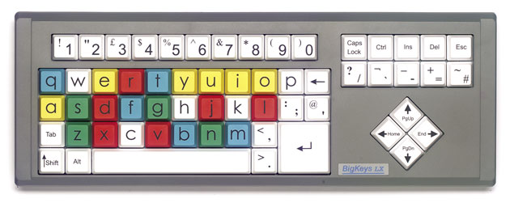
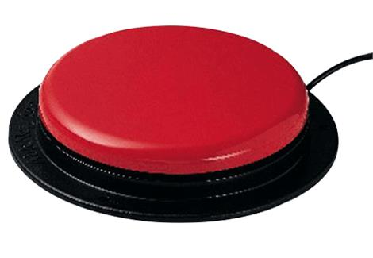
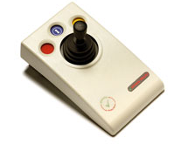
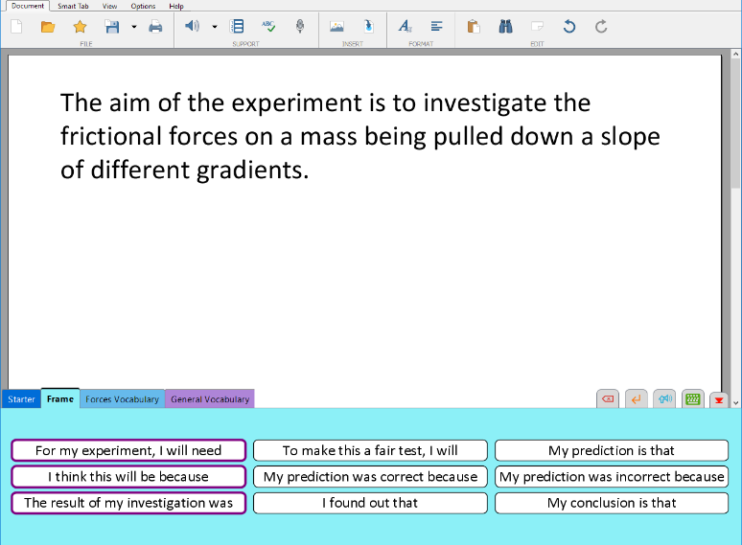
Alternative input devices
Switches, keyboards, eye-gaze – generally considered adjunct to Word processing
BUT
Access software must be checked with awarding body to ensure assessment criteria are not compromised
Grids
Word prediction

Slide 14
Does assistive technology cost money?
Maybe….
There are free options but you may have to compromise on
Features
Supports
Compatibility
Free options requiring internet access are good can be used at home or in college but

Slide 15
Built-in Enabling Technologies
 | Windows / Office | Mac | Chrome | iOS | Android
Text to speech | yes | yes | With extension | yes | yes
Colour filters / background | Limited. Free/Paid tools | Limited. Paid tools | With extension | yes | Limited
Speech recognition | yes | yes |  | yes | yes
Predictive text | Touch-screen / external keyboard | Touch Bar | With extension | yes | yes
Spellcheck / dictionary | yes | yes | yes | yes | Spell check only
20 different types of technology could be used to remove barriers to reading, writing, drawing & communicating

Slide 16
Computer Reader options
Computer Readers | Adobe Read Out Loud | Orato (CALL Scotland) | ClaroRead SE | Read & Write Gold
Control method | Keys | Floating toolbar | Floating toolbar | Floating toolbar & PDF Aloud application
Voices included | No | No | Yes | Yes
Highlighting as text read aloud | No | In separate text window | Yes, in Adobe Reader | Yes, in PDF Aloud
Provide range of literacy support tools | No | No | No (ClaroRead Pro alternative) | Yes
APPS (ipad, Android without internet access) |  |  | ClaroPDF (iOS) ClaroScan (iOS & Android)
Cost | No | No | Yes | Yes

Slide 17
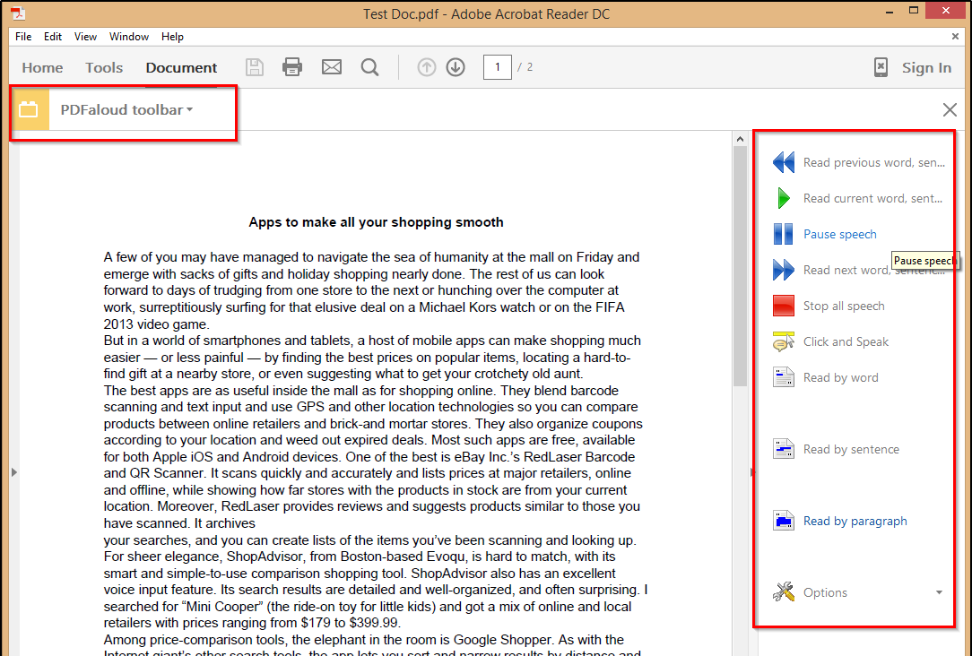
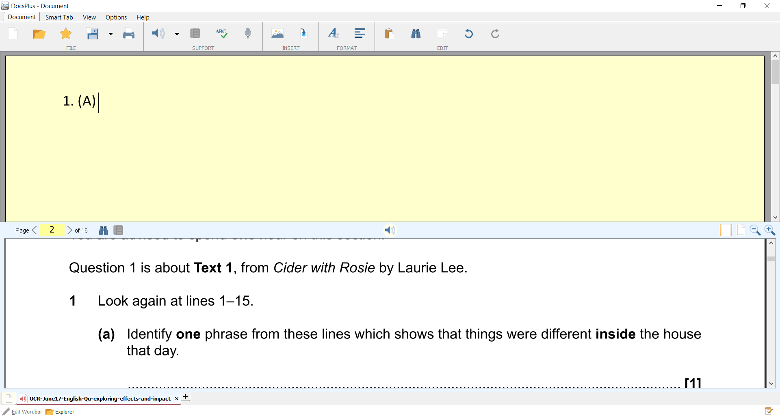
Other (commercial) options
Texthelp Read&Write
ClaroRead
Crick DocsPlus integrate text to speech, word processing & PDF reader
Notes:
Texthelp Read&Write for Chrome / Google Docs, PC / Mac, iPad
ClaroRead Software – range of software and apps
Crick software – Clicker and DocsPlus integrate text to speech with Word Processing

Slide 18
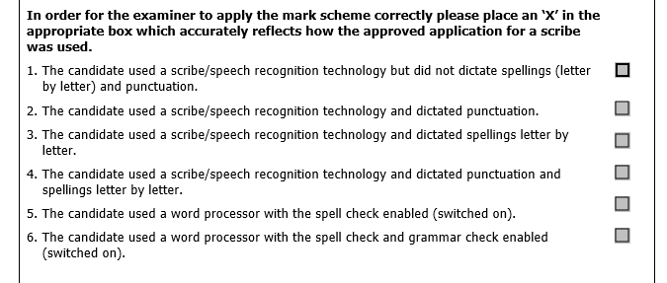
Technology Scribe and Spelling, Punctuation & Grammar marks for GCSEs
Scribe cover sheet responses used to allocate which SPAG marks can be awarded
If candidate can word process (with spell check) or dictate including punctuation, only spelling marks removed
Note: marks in GCSE English Language are throughout the assessment criteria.

Slide 19
Example: why isn’t everyone using text to speech in the classroom?
It costs too much
It’s not reliable
My pupils can’t type fast enough
I don’t know how to use it
Teachers use books & worksheets
My pupils don’t like it
Notes:
My pupils are not good at typing
I can’t get books on to the computer

Slide 20
But…
Free, low-cost or commercial tools are available
Training is important for everybody, staff and pupils.
Not everyone likes technology. Find your tech champions,
Free scanning apps & RNIB Bookshare help with digital learning resources
Notes:
My pupils are not good at typing
I can’t get books on to the computer
; balance the different levels of support and features against your budget

Slide 21
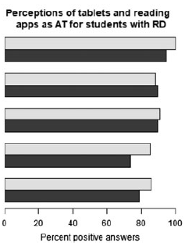
Impact and training AT apps for dyslexic learners (Nordström et al, 2018)
80% primary & 57% secondary pupils felt the TTS assist reading skills
But extensive training & support was required. Some students struggled to use apps
70% continued to use AT after project
Enhance learning opportunities
Enhance reading development
Enhance text comprehension
Improve ability to write text
Assist educational practice
Notes:
Nordström, T., Nilsson, S., Gustafson, S., & Svensson, I. (2018). Assistive technology applications for students with reading difficulties: special education teacher’s experiences and perceptions. Disability and Rehabilitation: Assistive Technology, 1-11. https://www.tandfonline.com/doi/full/10.1080/17483107.2018.1499142

Slide 22
Final thoughts
Keep it simple!
Supplement current strategies
Use what’s already in your pocket
Highlight benefits
Focus on motivation
Accept that not everyone will want to use technology
Work together
Pupil/teacher ---- user/trainer partnership
Whole-organisation approach

Slide 23
Resources
Abi James: Abi@assistivelearning.co.uk
Training: Communicate-Ed, PATOSS, JCQ AAO training site
CALL Centre Scotland : www.adapteddigitalexams.org.uk
JISC: Centre focused guidance: https://www.jisc.ac.uk/guides/making-the-most-of-accessible-exam-papers
JISC Learner focused guidance : https://www.jisc.ac.uk/guides/digital-exam-papers-for-people-with-print-disabilities
Runshaw College project on use of TTS in exams: http://lfuturesnews.co.uk/wp-content/uploads/2015/11/Runshaw_Final-Report_2015.pdf

Slide 24
Supervised Rest Breaks (centre delegated)
Should be considered before applying for extra time.
Must be due to a substantial difficulty and normal way of working (e.g. in mock exams)
Timing of the examination should be paused and re-started when the candidate is ready to continue.
Up to SENCO to determine likely length of breaks
During the supervised rest break the candidate must not have access to the question paper/answer booklet.

Slide 25
Maths content
Human readers must not read maths symbols
Options for scribing maths
Equation editor in Word (if autocorrect, spell-checker etc turned off)
Free equation editor Mathcast enables equations to be copy & paste into WordPad, DocsPlus etc http://mathcast.sourceforge.net
Students studying maths at A-level and beyond should consider learning LaTeX if they need to use a computer
Speech recognition / dictation for maths equations is complex!

