Slide 1

British Assistive Technology Association
Myles Pilling
Council Member & Director

Slide 2



“Raising the awareness of Assistive Technology in the UK”

Slide 3

Aims
Campaign
Campaign for the rights and interests of those needing AT
Provide
Provide expert , impartial and advice to government
Educate and inform
Educate and inform widely on AT
Promote
Promote British AT products and expertise at home and overseas
Develop
Develop the professionalism of those working with AT
British Assistive Technology Association

Slide 4
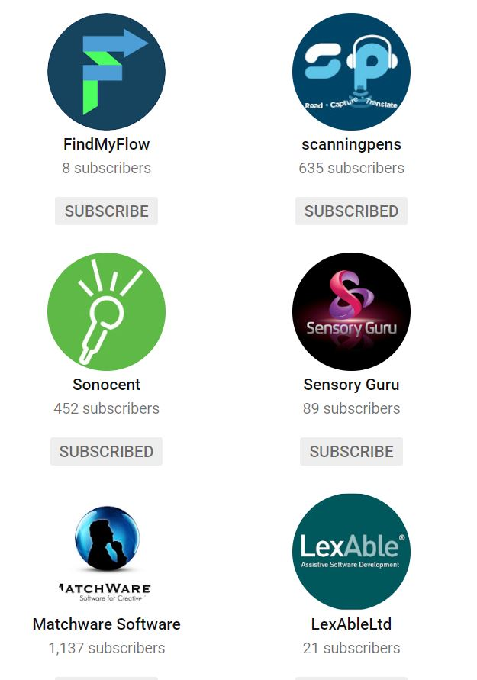
Who we are
100 members and growing from :-
Commercial Assistive Technology businesses
Schools, Higher Education, Further Education and Local Authorities
Third Sector – charities and organisations
Individuals – assessors, assistive technologists, professionals
Drawn from a wide range of settings
Run by Volunteer Board of Directors
Working towards making Assistive Technology accessible for ALL

Slide 5
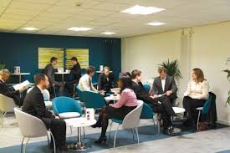

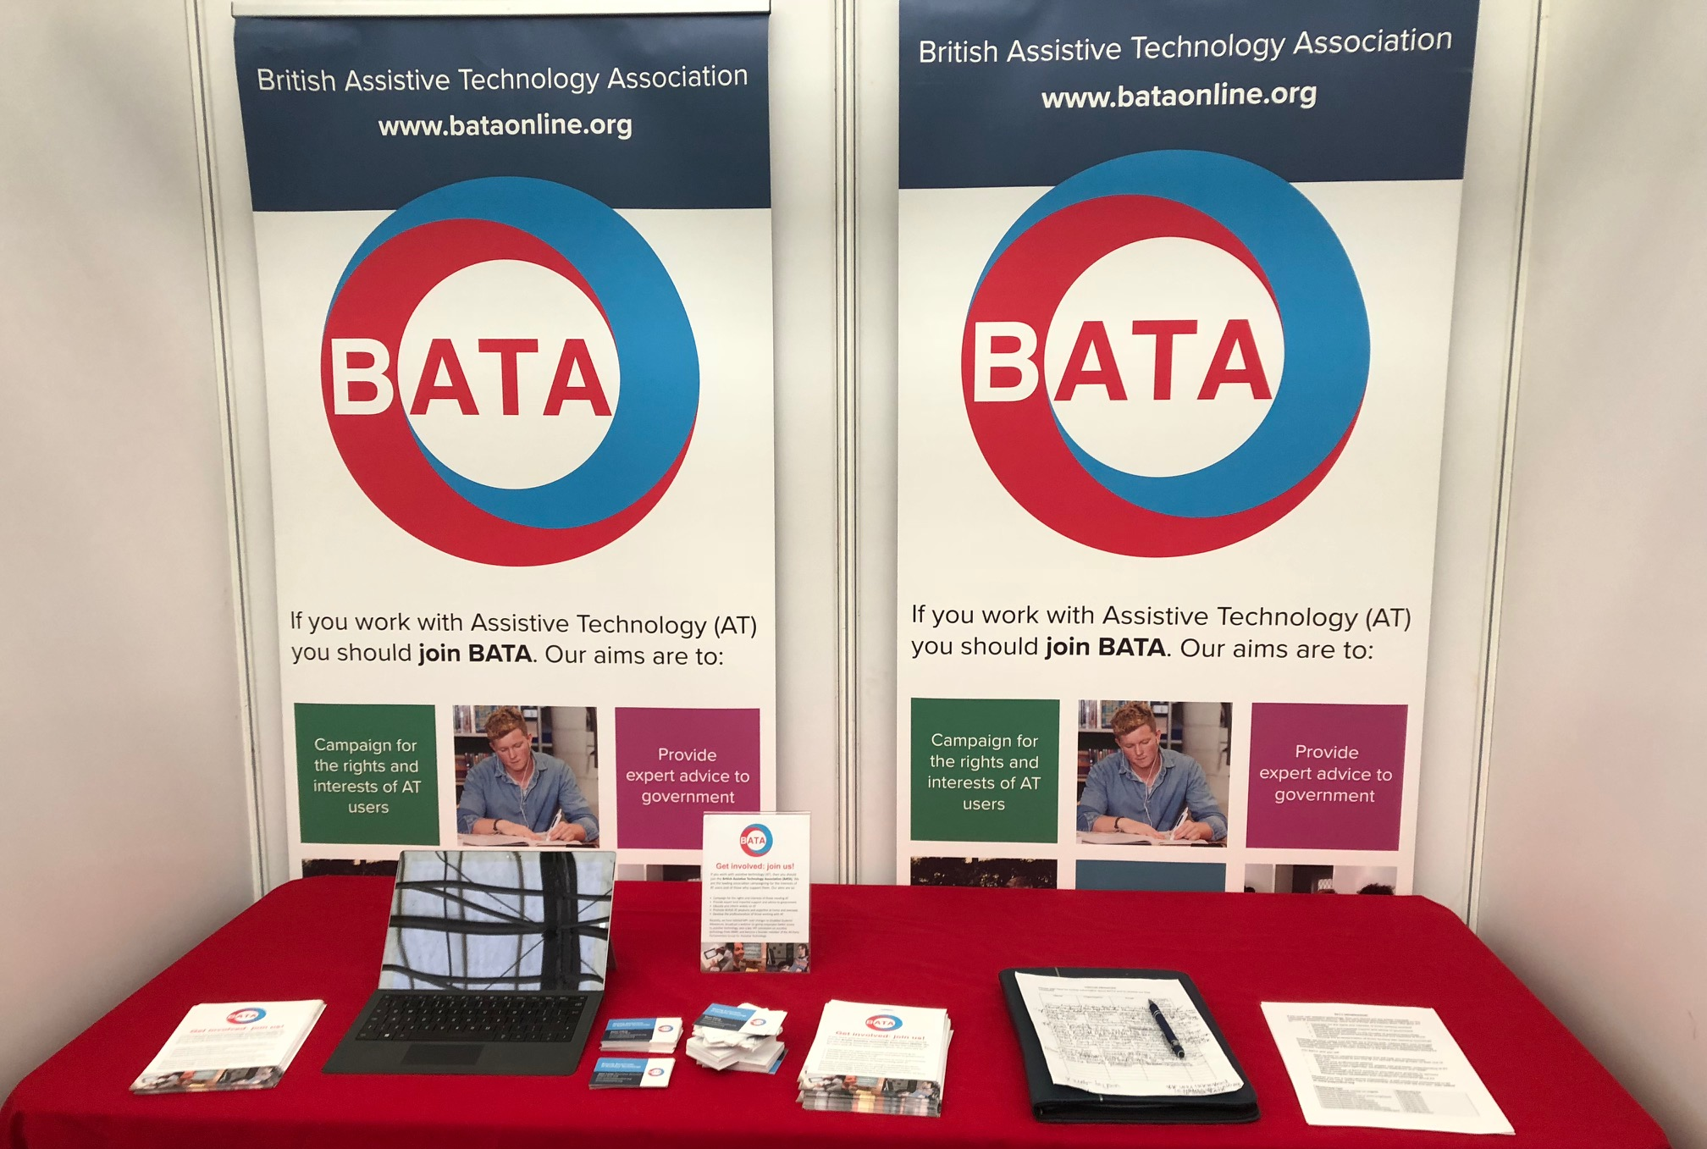
What we do
Campaign
Inform
Events, Conferences & Exhibition
Discuss
Promote

Slide 6
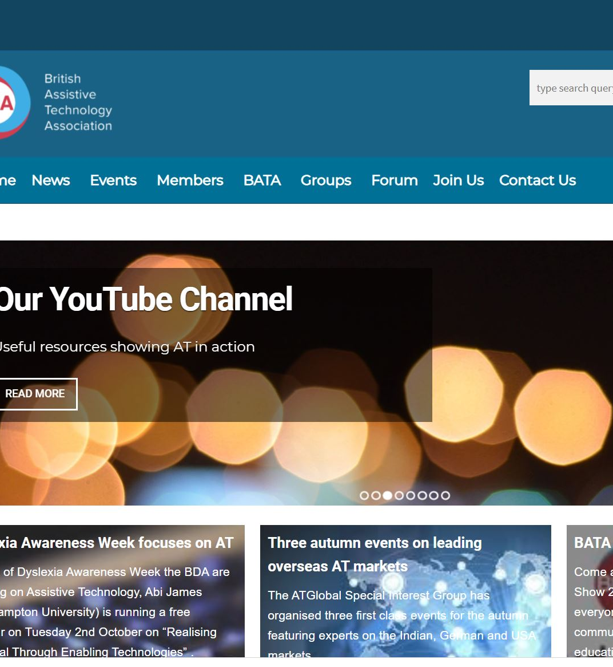
Areas we are working on
Accessible exams​
Disabled students’ allowances​
VAT on assistive technology​
Training and accreditation​
Software licencing​
Procurement​
Exporting AT​
Refreshing our website and branding​

Slide 7
What we have achieved
Lobbied MPs over changes to Disabled Students’ Allowances
Broadcast webinars on:-
AT into the Workplace
Accessible Education
AT into India
Won a key VAT concession on Assistive Technology from HMRC
Became a founding member of the All-Party Parliamentary Group for Assistive Technology

Slide 8

How can you help?
Visit our website:
http://bataonline.org.uk
Subscribe to our free newsletter
Join BATA
THANK-YOU!

