Slide 1
SEN Coding
Simon Barnett, Multimedia Tutor, National Star College
Notes:
Open with a wireless switch to progress the PowerPoint
Overview of who I am and what level of learner I teach. Background about teaching higher level learners HTML, CSS, C++ Etc
There will be a group participation
Resources used

Slide 2
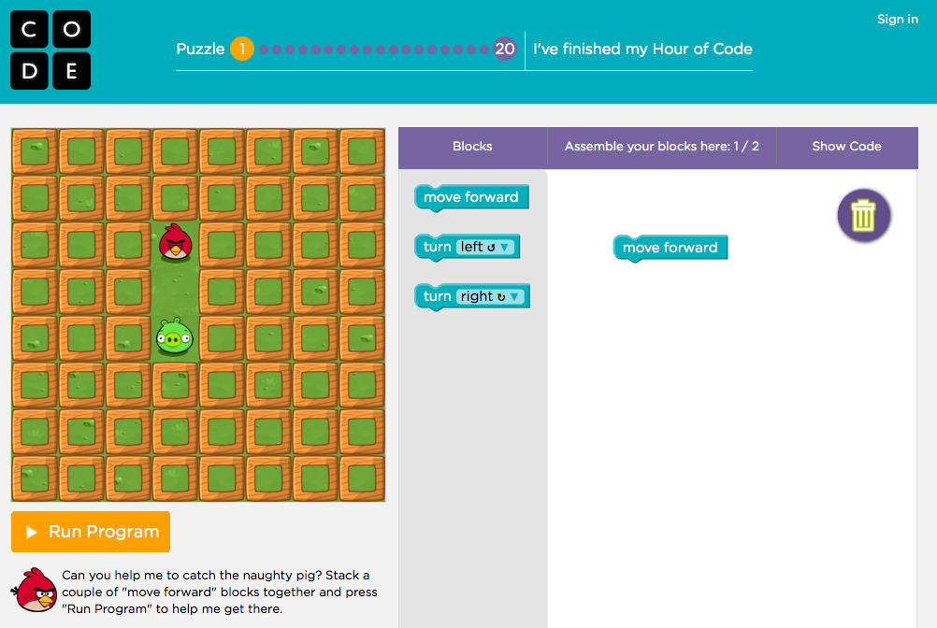
Death by PowerPoint!
Notes:
Link to basic coding for any level. Matching, cause and effect.

Slide 3
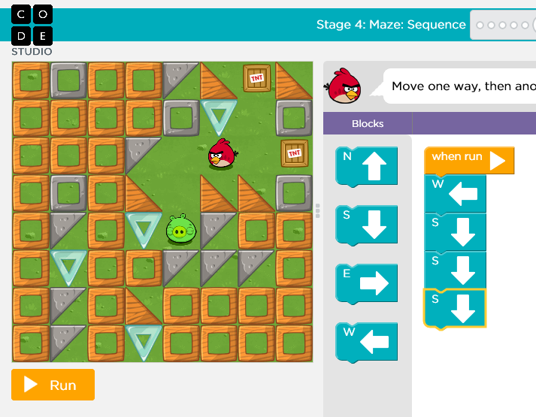
SEN Visually Impaired Team Coding…
Notes:
Maths concepts. Volunteers to take part. Arrows and compass on the floor/ walls
Blind fold volunteer

Slide 4
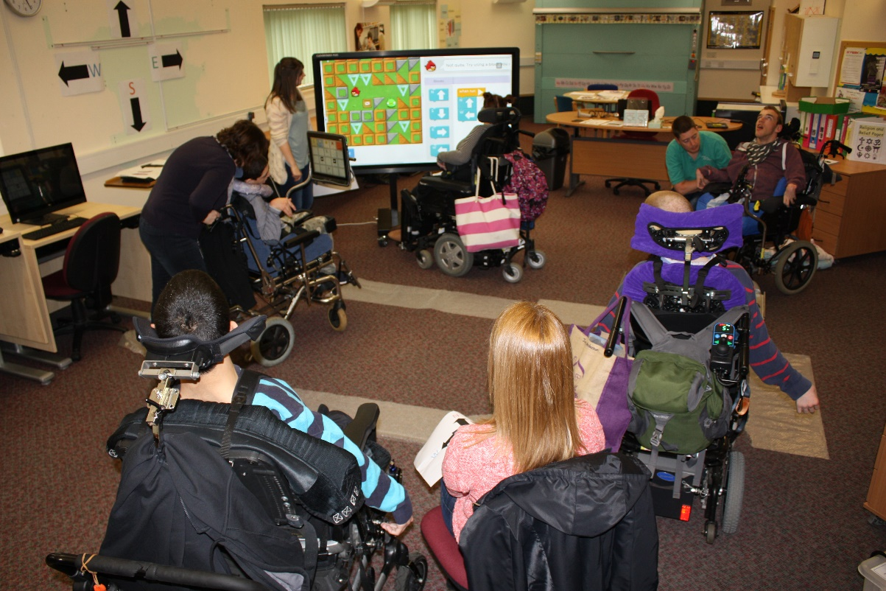


SEN visually impaired coding
Notes:
Cause and effect and problem solving skills. Tell the story from Alex’s point of view. Directions programmed. Problem solving. Pop!

Slide 5


Making the link…

Slide 6





To make the bird flap when you click the mouse you must drag and attach the flap block.
What sound does a bird make when it flaps its wings?

Slide 7
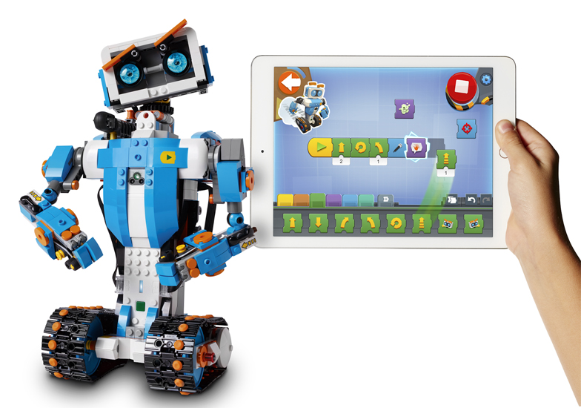
Applying the knowledge and transferable skills…

Slide 8
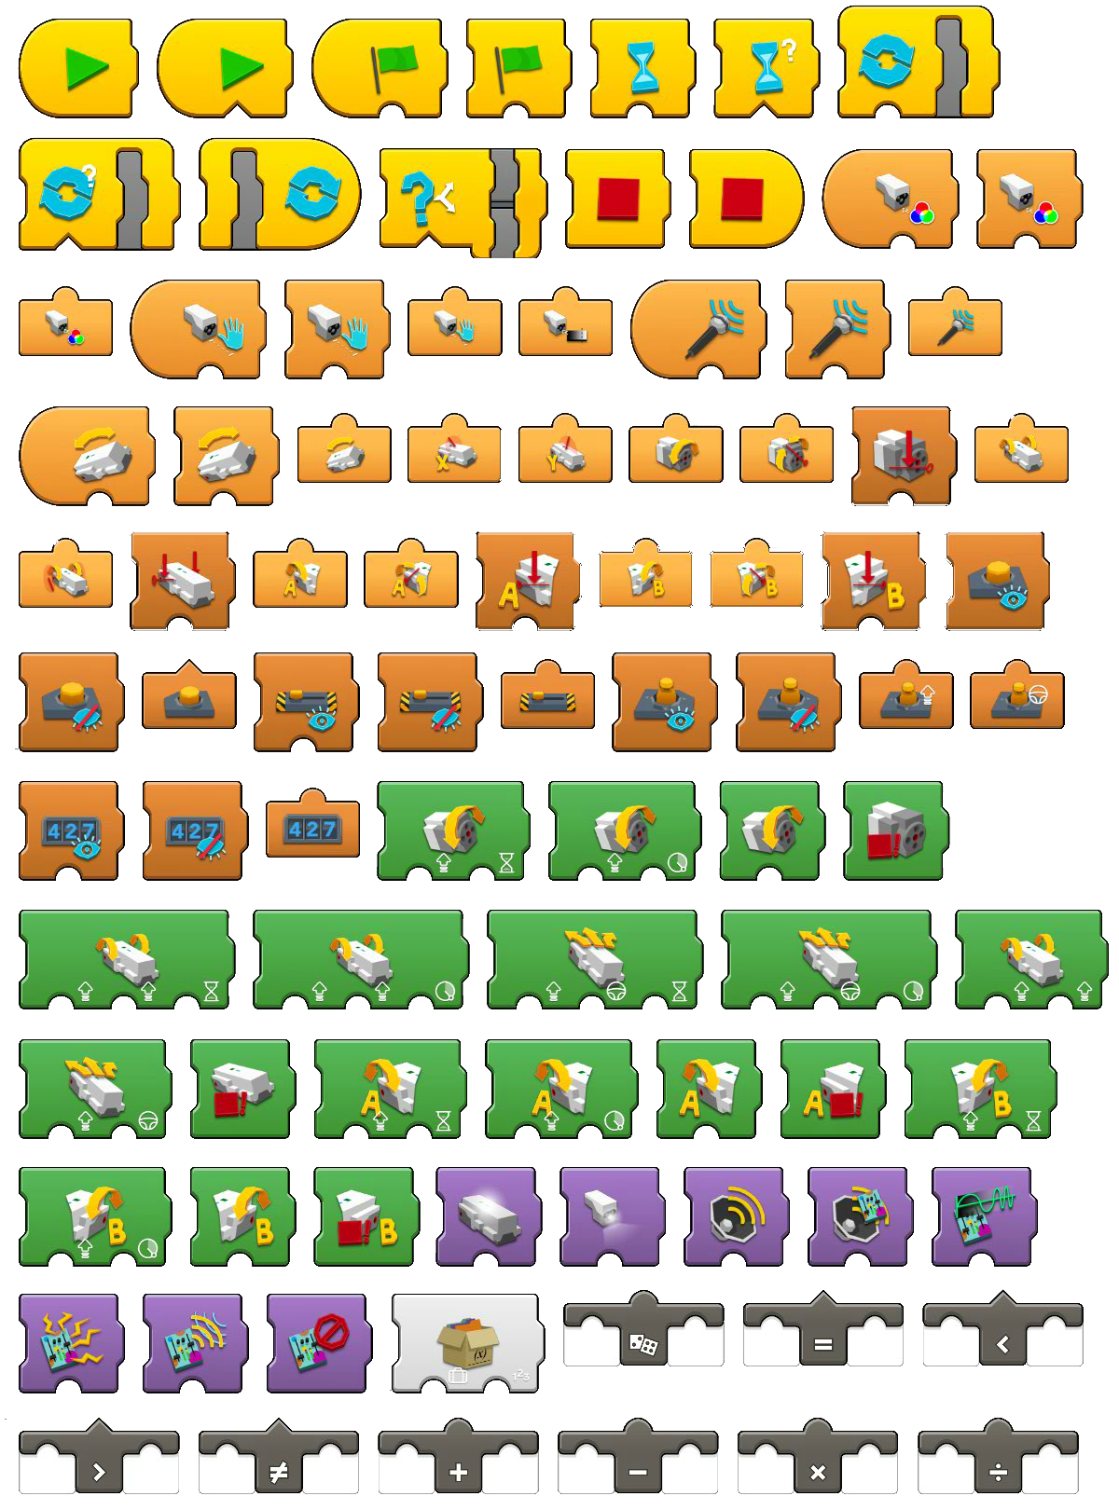

Slide 9
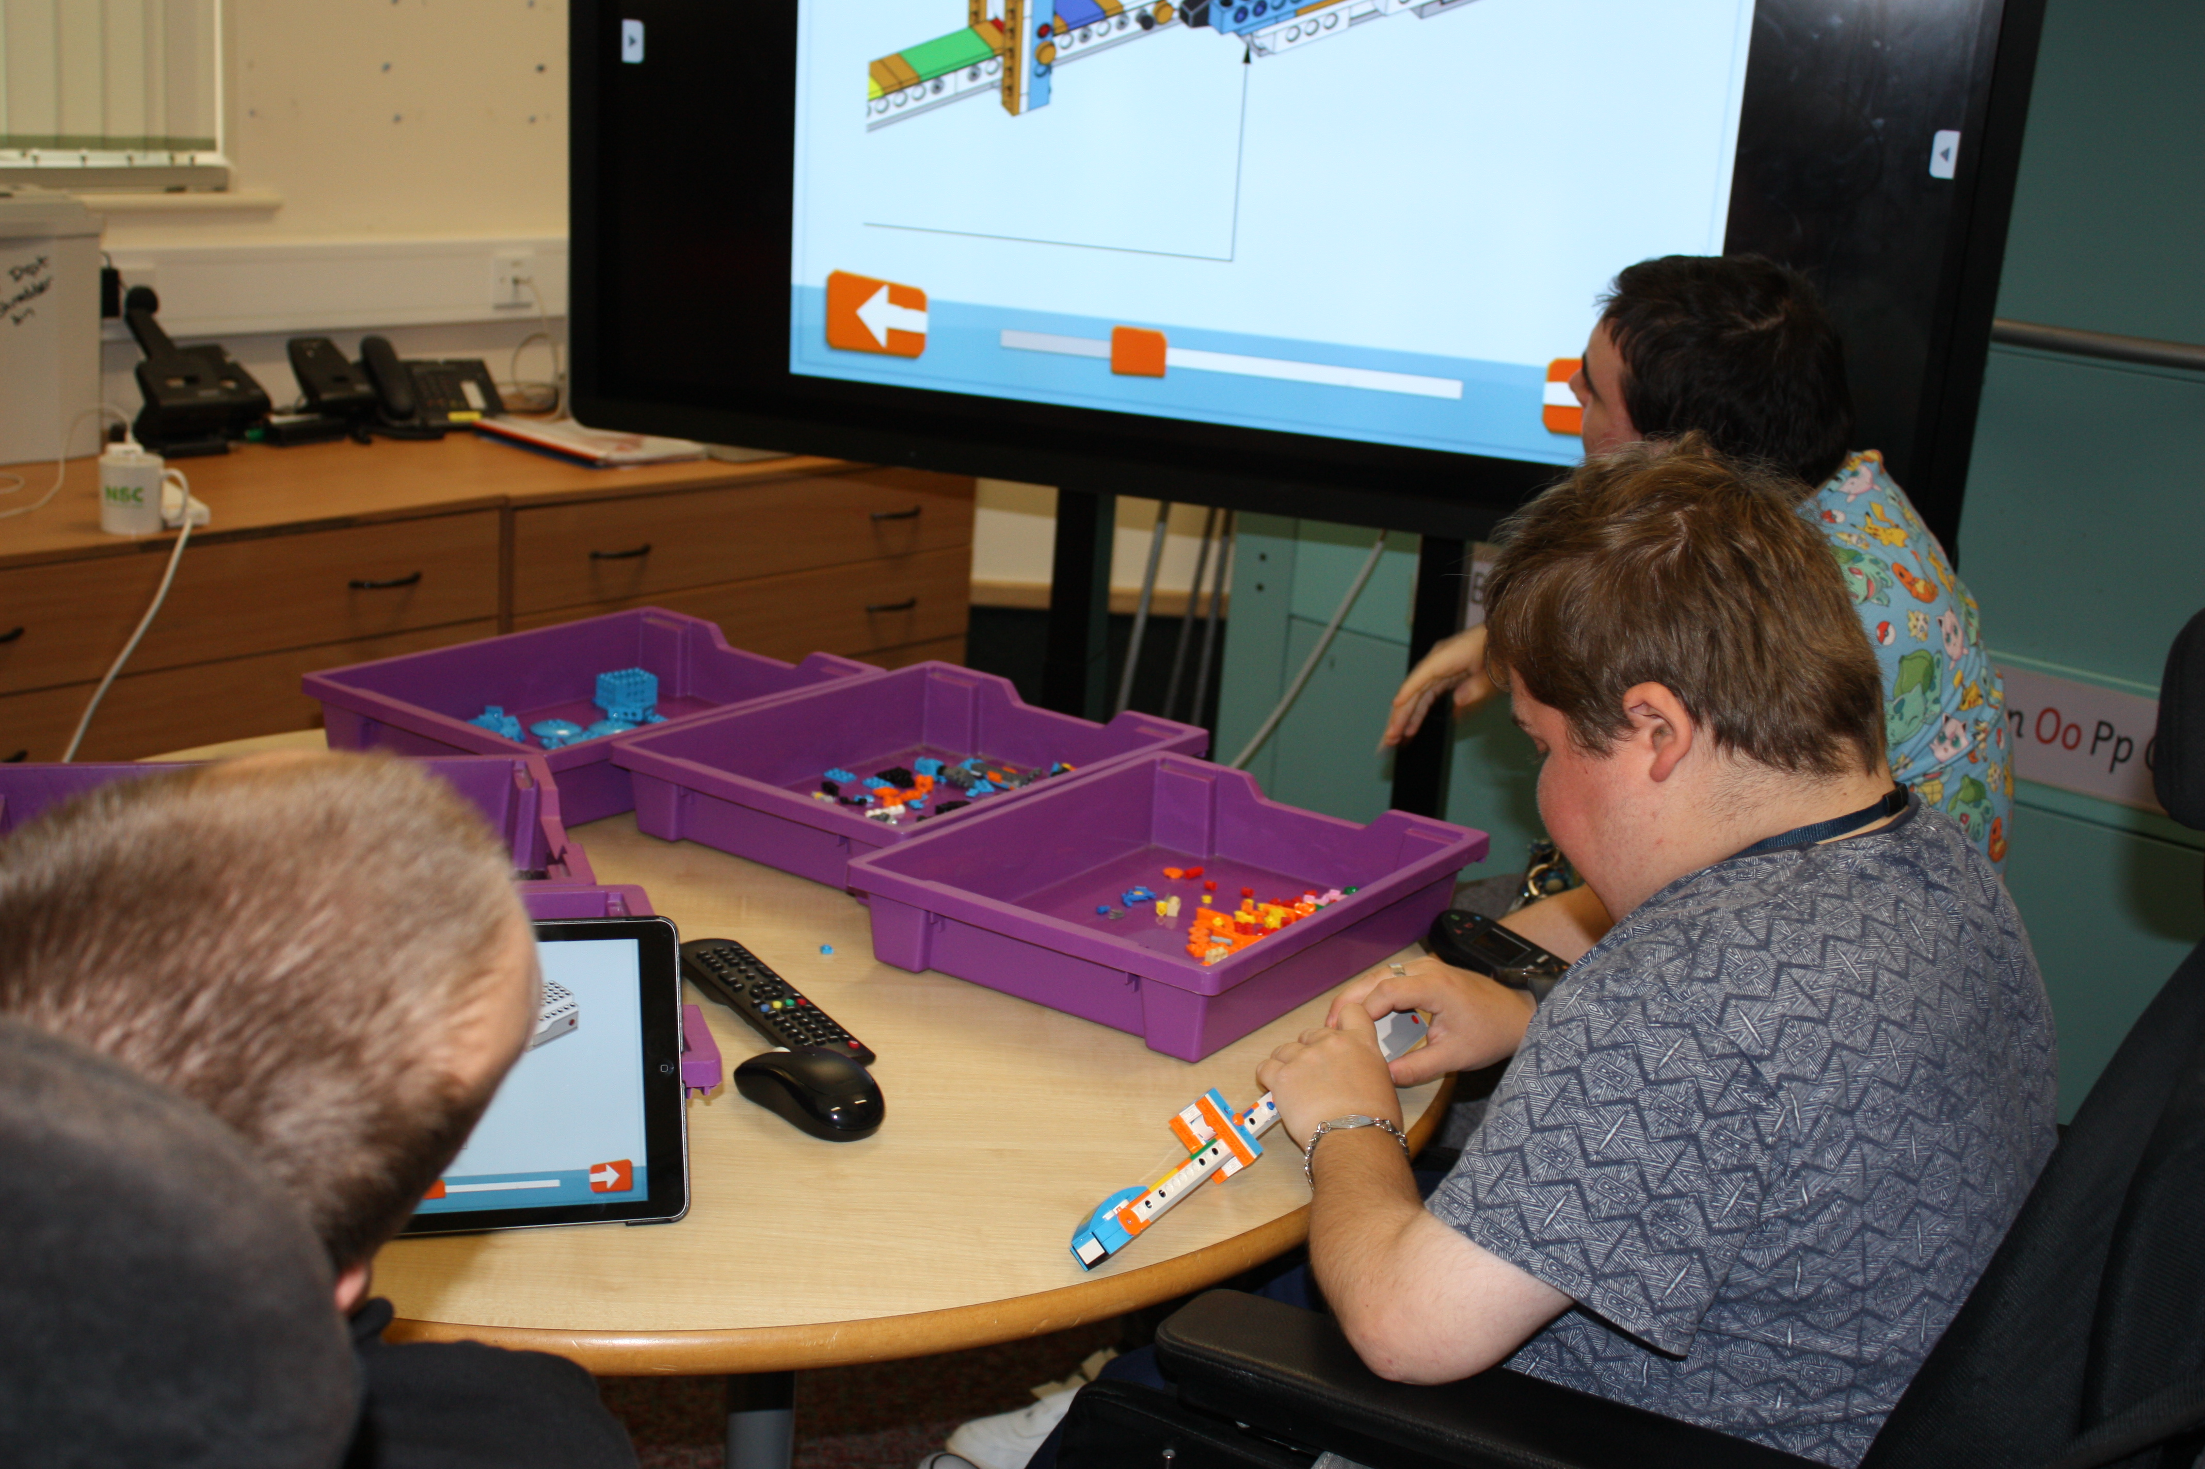
Collaboration…

Slide 10
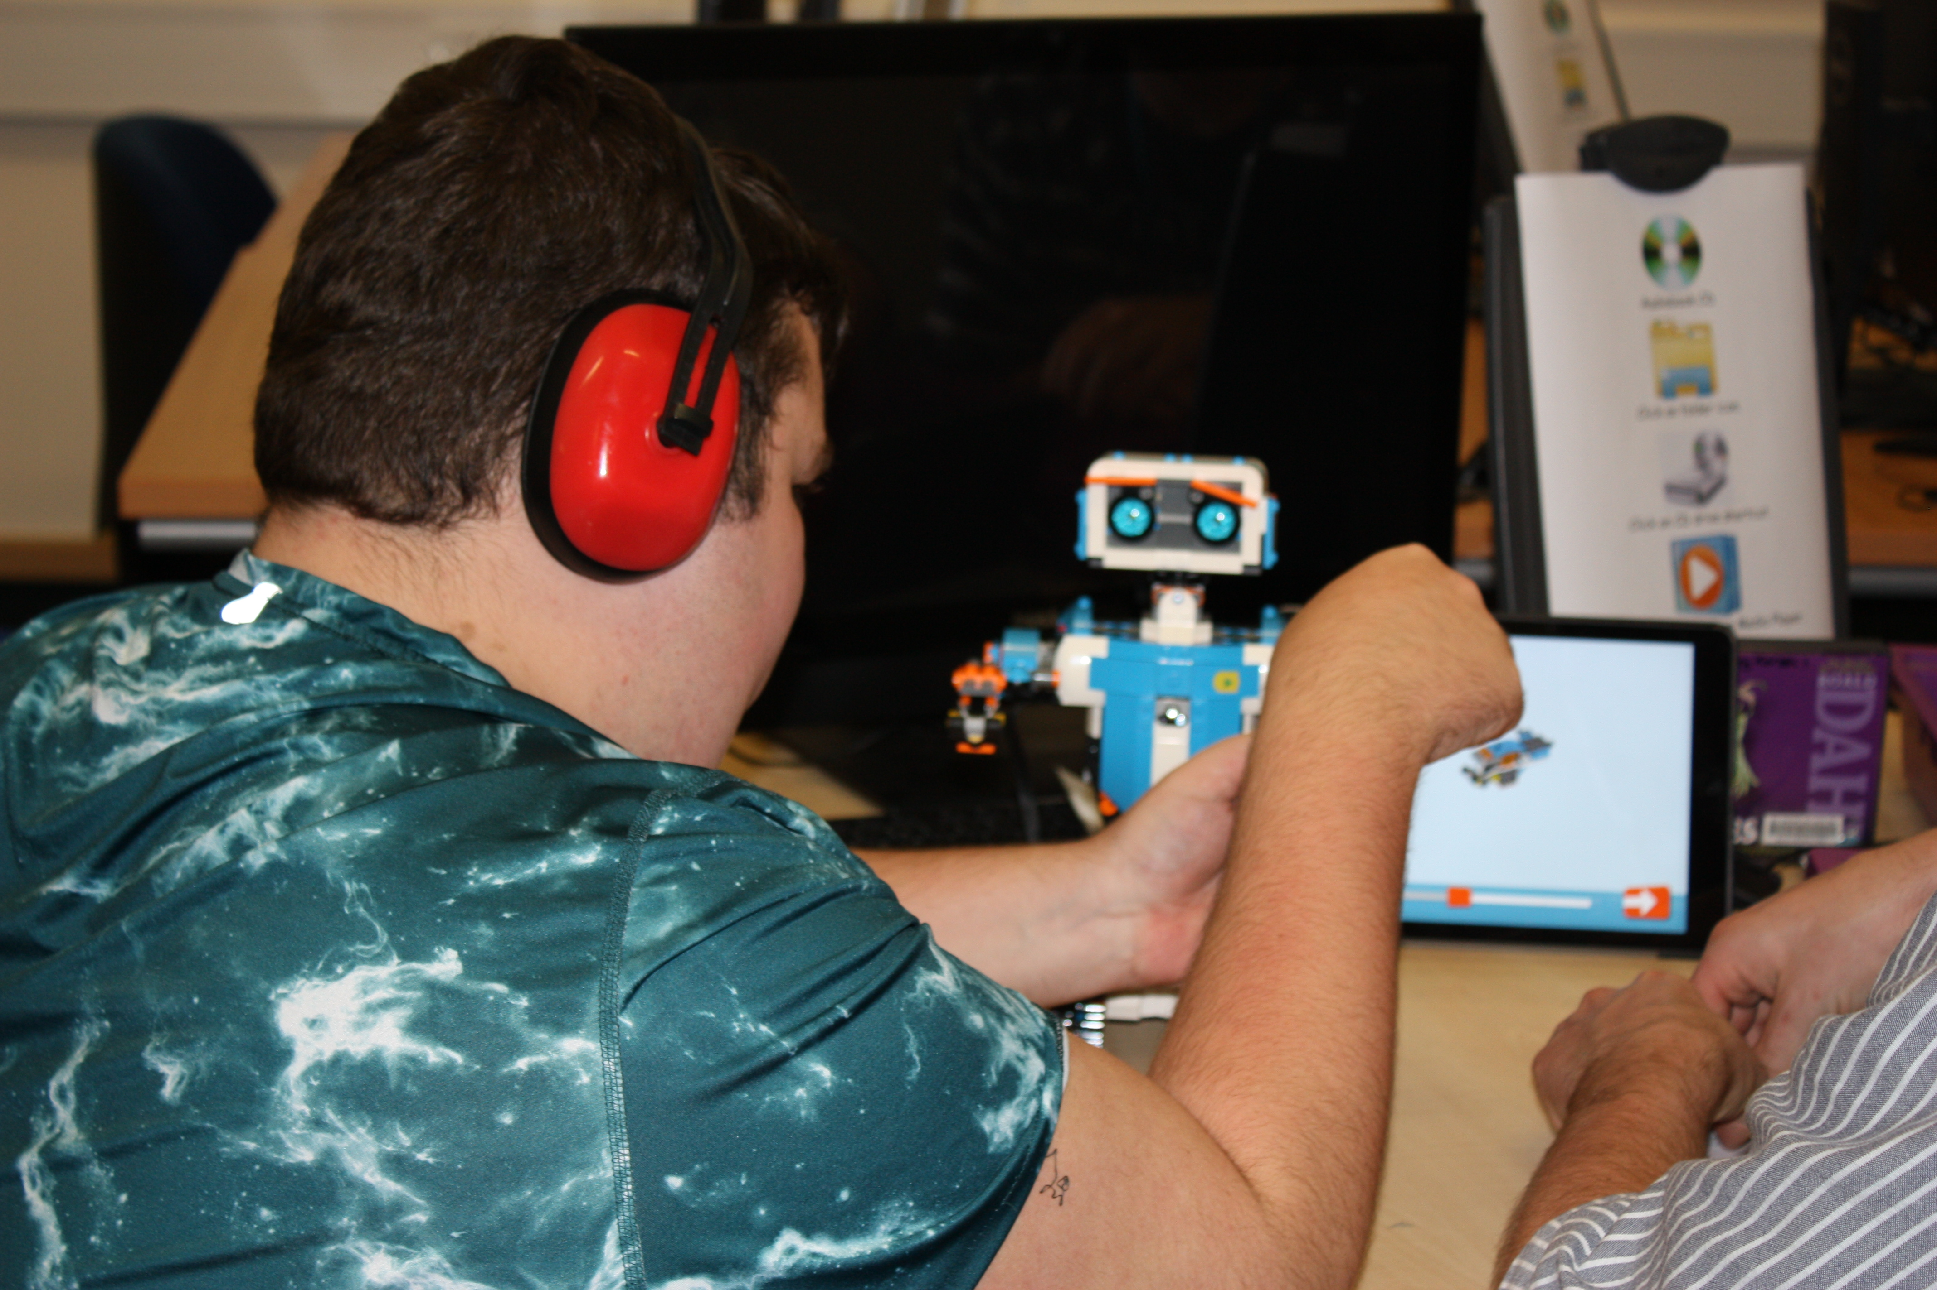
Removing the barrier…

