Slide 1

Grid 3 for Education
Trevor Mobbs
Notes:
Who I am and Smartbox history
New home in Malvern

Slide 2

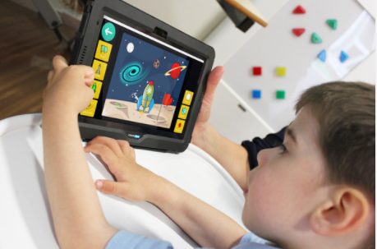

Grid 3 Software
Grid 3 software empowers people with disabilities to communicate, access education and to be independent.
Easy Editing
Beautifully Simple
Endless possibilities
Powerful
Notes:
Over 300 activities
Pathway of learning, for every point of the communication journey,
Learning cause and effect to curriculum access.

Slide 3








Text communication
Symbol communication
Computer
control
Environment
control
Accessible
apps
Interactive
learning
Education
Notes:
When we talk about Grid 3 we often refer to the ‘7 areas’. Users tend to use one, several or even all of these areas when using the software.

Slide 4
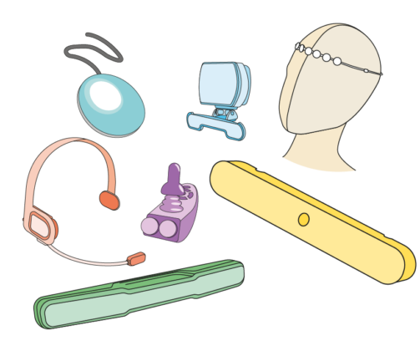
Alternative access for everyone
Access suited to the individual
Switch Access
Eye Gaze
Head Pointers
Gyroscopic Head Mouse
Joystick Access
Voice Activation
Keyguards & touch options
Notes:
Software and hardware to meet every need

Slide 5

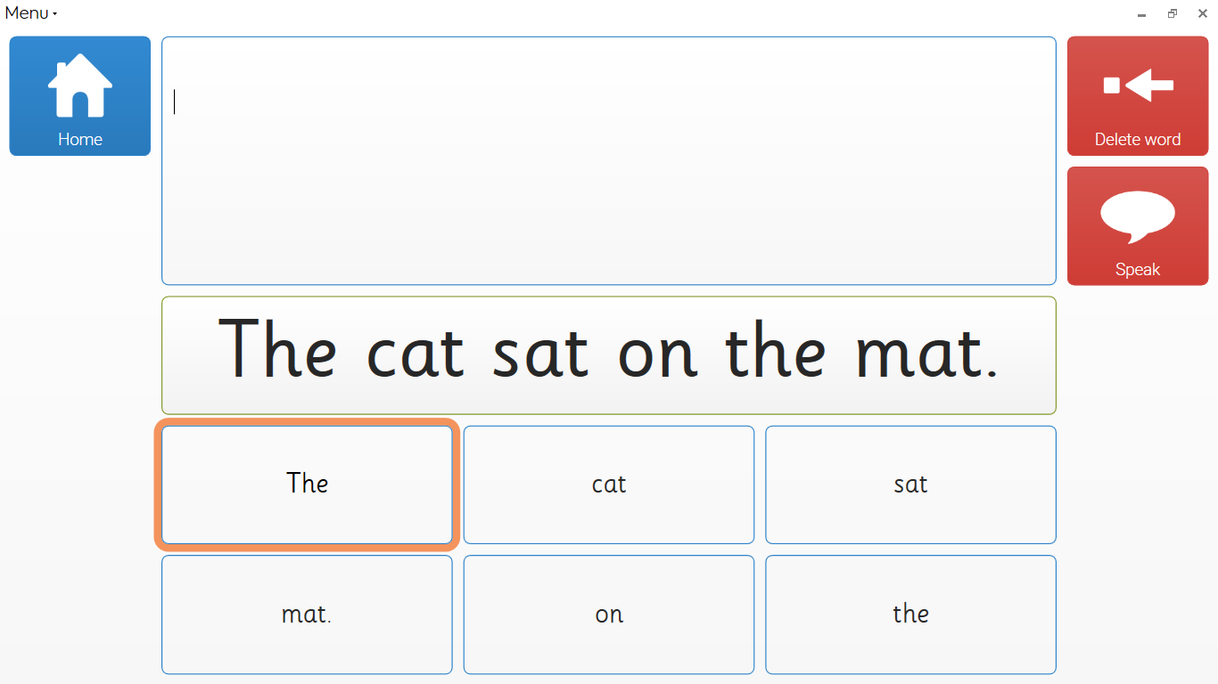

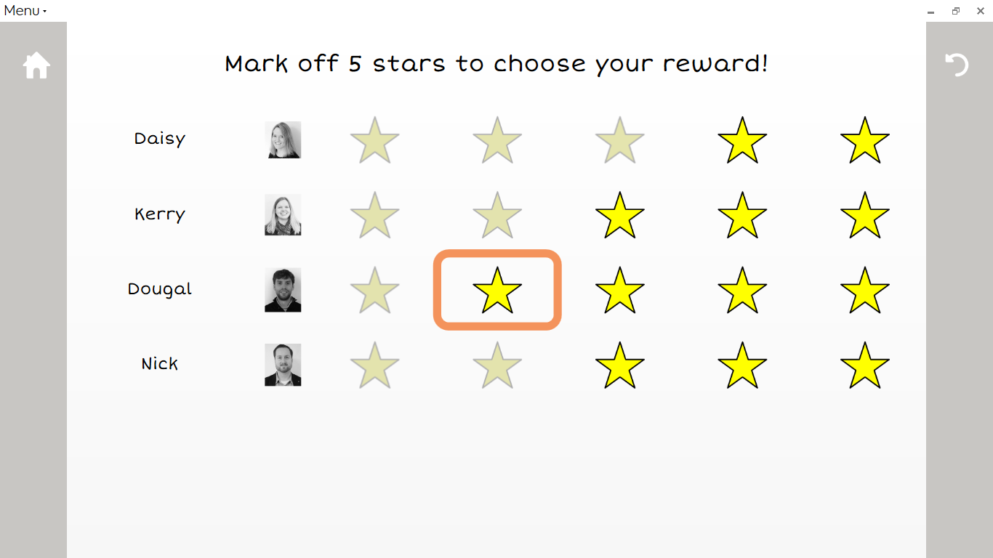
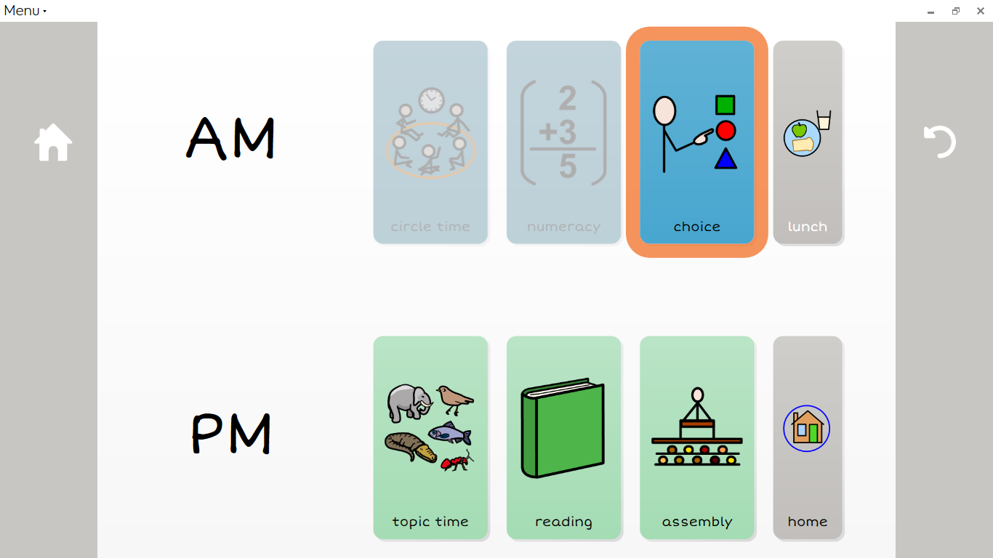
Grid 3 for Education
What is Grid 3?
Resources and ideas:
  Start of the day
  Organisation
  Communication for learning
  Supporting literacy
  Assessment
  Independence & Choice making
  Leisure
Grid for iPad
Education Licence
More information and support

Slide 6
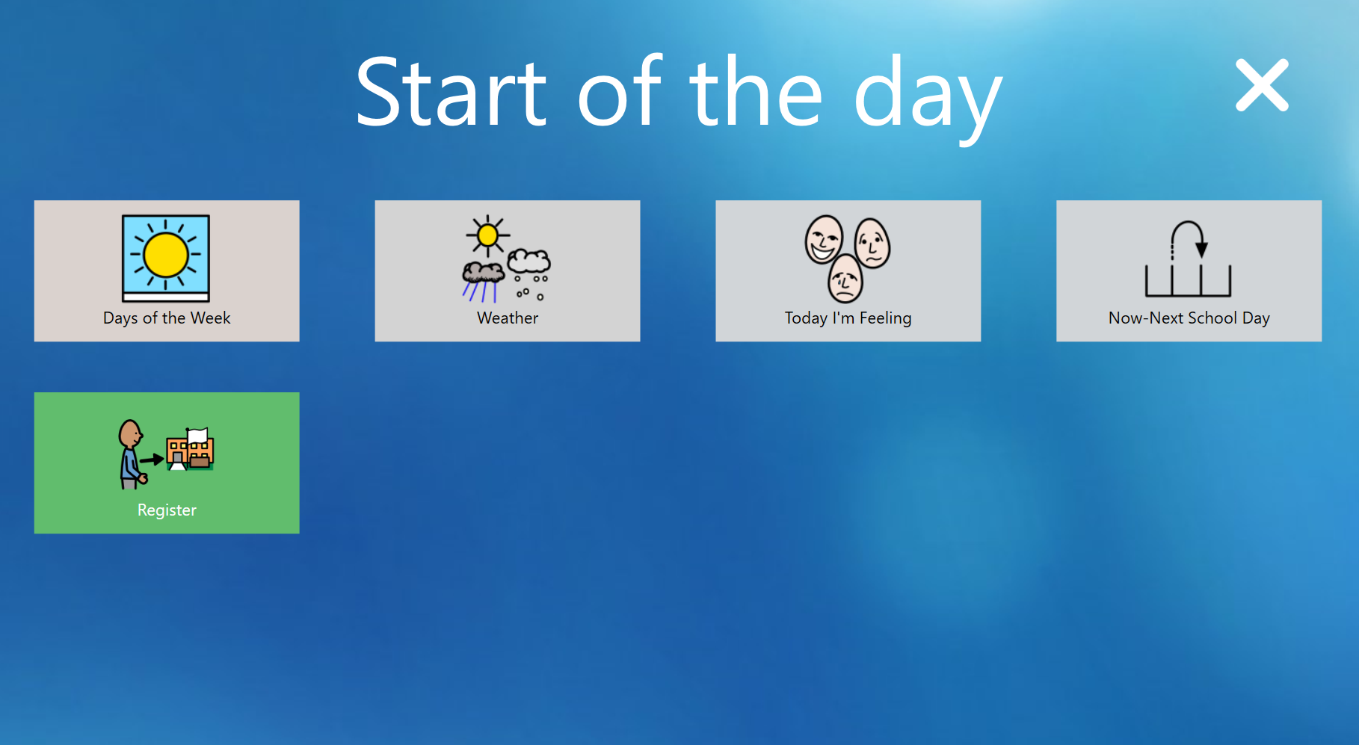
Notes:
Software and hardware to meet every need

Slide 7
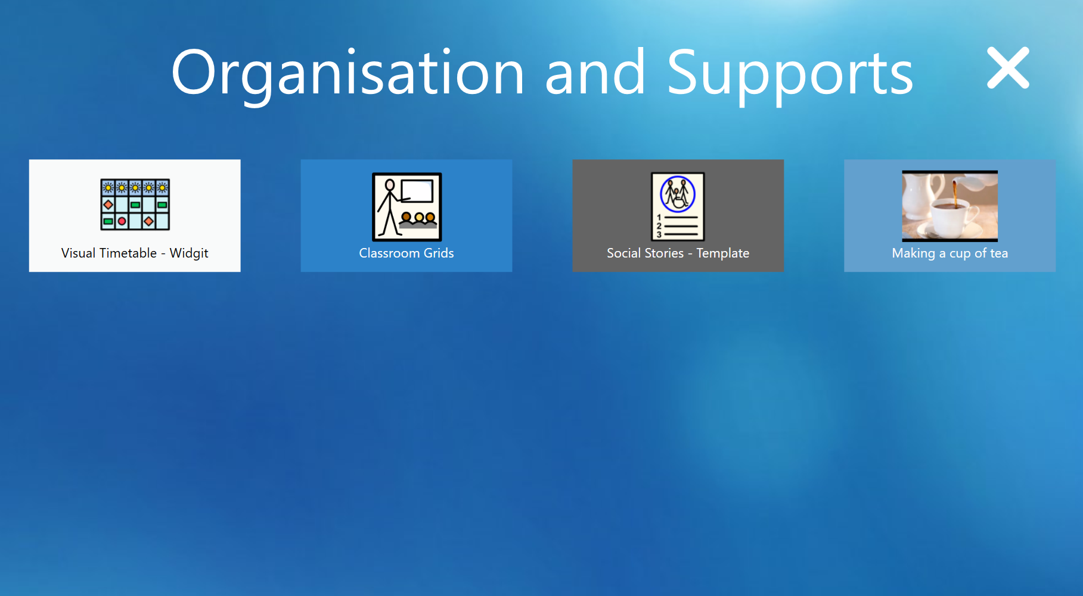
Notes:
Software and hardware to meet every need

Slide 8
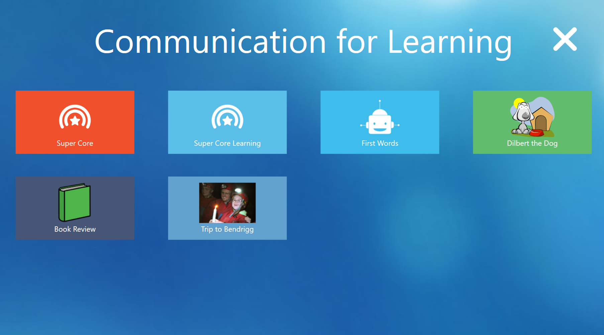
Notes:
Software and hardware to meet every need

Slide 9
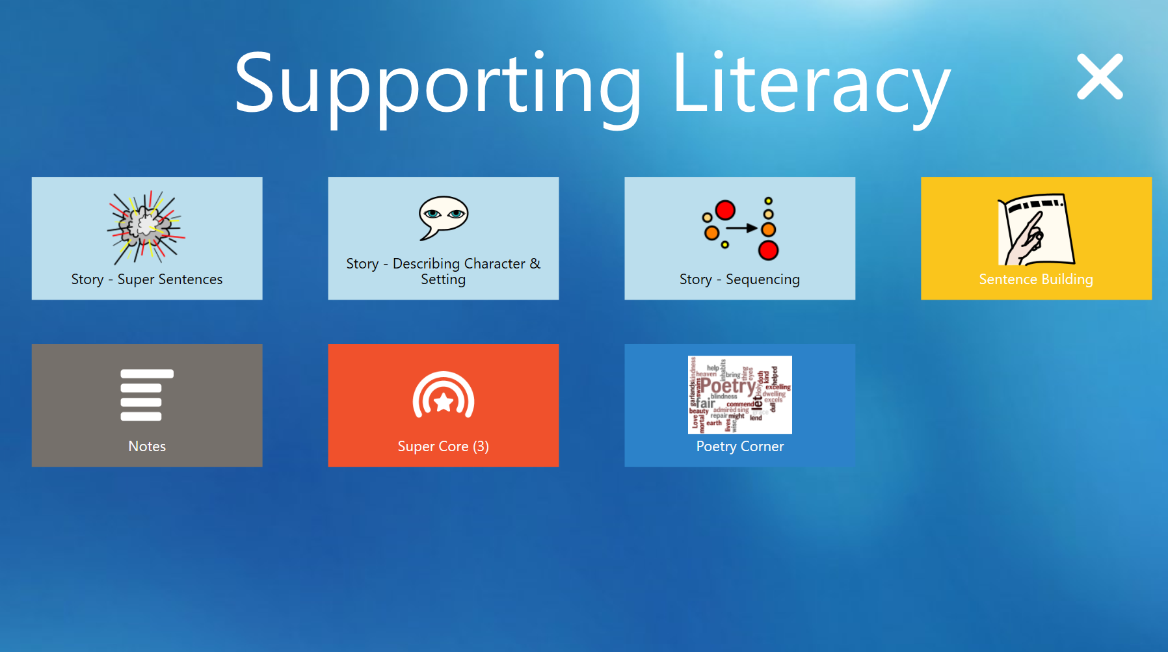
Notes:
Software and hardware to meet every need

Slide 10
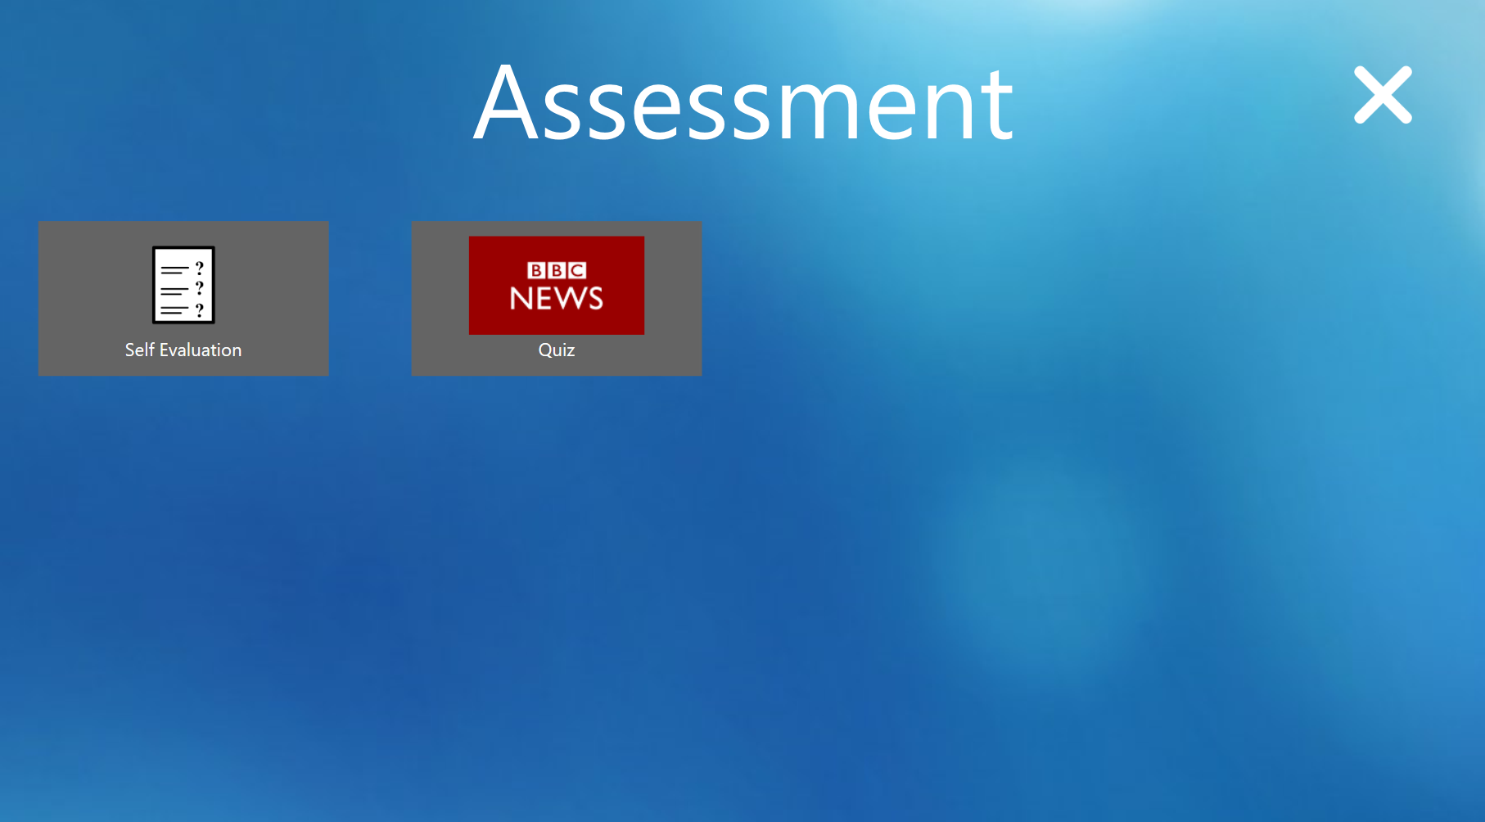
Notes:
Software and hardware to meet every need

Slide 11
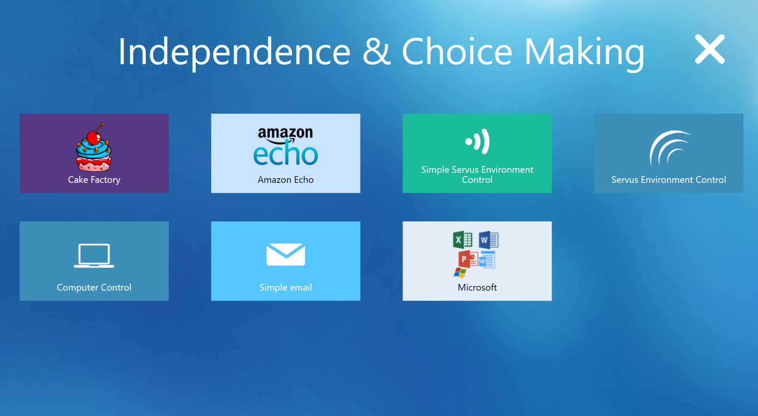
Notes:
Software and hardware to meet every need

Slide 12
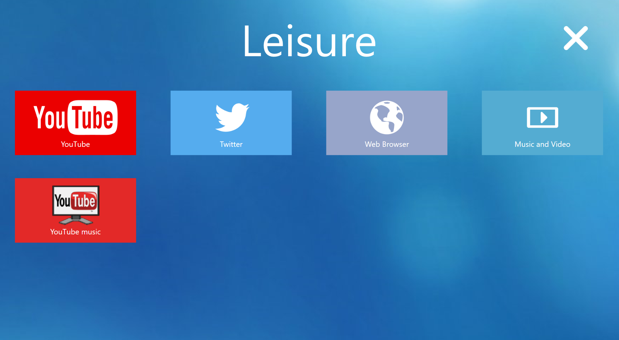
Notes:
Software and hardware to meet every need

Slide 13
Download all resources
https://goo.gl/WdJnn4
Open Grid Explorer, go to Menu, Users
Choose Restore Backup and select the downloaded file
Notes:
Initial minimum Purchase of 20 licences but can add on additional licences at any time. No need to know exact number before initial purchase.
Simple pricing – one price £180
Smarter Installation and Use – Token leasing system. 24 hr buffer if it goes offline.
Not limited to school site. As long as online you can use it anywhere.
SB support team. PCS symbols £20 per licence and Training from Smartbox £450 to get the most out of the licence.

Slide 14
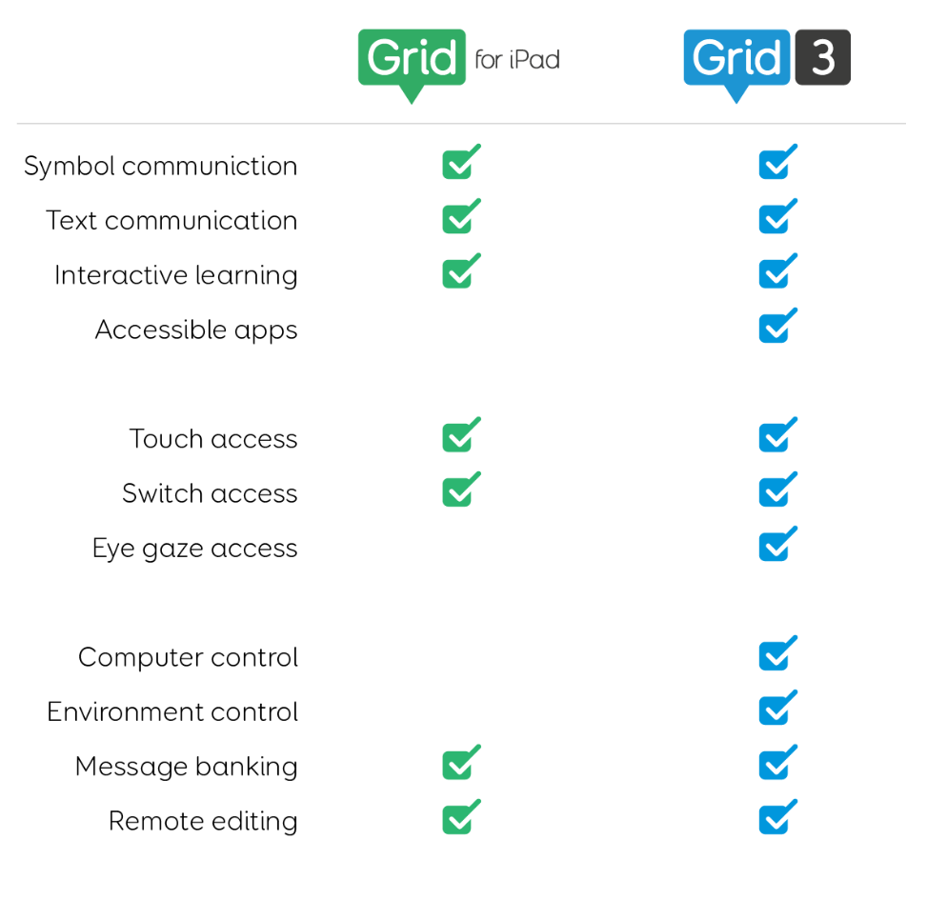

Grid for iPad
£9.99 per month
or
£349.99 (-50% for colleges via VPP)
Notes:
Initial minimum Purchase of 20 licences but can add on additional licences at any time. No need to know exact number before initial purchase.
Simple pricing – one price £180
Smarter Installation and Use – Token leasing system. 24 hr buffer if it goes offline.
Not limited to school site. As long as online you can use it anywhere.
SB support team. PCS symbols £20 per licence and Training from Smartbox £450 to get the most out of the licence.

Slide 15

Grid 3 Education Licence
Grid 3 is available as a multi-user Education Licence available as a one-off purchase for your network
Flexible Purchasing
Simple Pricing - £180 each for 20+ copies
Smarter Installation and Use
Freedom of Use
Specialist Support & Optional Extras
https://thinksmartbox.com/product/grid-3-education-licence/
Notes:
Initial minimum Purchase of 20 licences but can add on additional licences at any time. No need to know exact number before initial purchase.
Simple pricing – one price £180
Smarter Installation and Use – Token leasing system. 24 hr buffer if it goes offline.
Not limited to school site. As long as online you can use it anywhere.
SB support team. PCS symbols £20 per licence and Training from Smartbox £450 to get the most out of the licence.

Slide 16
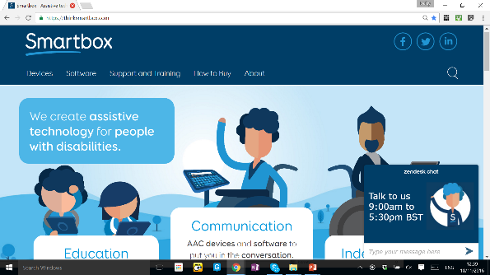
Support
Assistive Technology Specialists
Team of support staff to take your calls
Online guides and help
Website dashboard
01684 578868
support@thinksmartbox.com
Facebook community https://www.facebook.com/groups/smartboxcommunity/
Twitter @ThinkSmartbox
Notes:
Join the facebook community!
Remote Editing
Training Cards (also on website/ videos)
Website – 1 in 5 queries

