Slide 1

Inside the Onion, Peeling back the layers of accessible practice.
Notes:
Inside the Onion, Peeling back the layers of accessible practice.
Alistair McNaught, Subject specialist for accessibility, Jisc

Slide 2

Inside every onion, is a dolphin
Notes:
Image of an onion with a cartoon dolphin inside it. Text reads “Inside every onion is a dolphin”…

Slide 3
Inside every onion, is a dolphin
“It is of interest to note that while some dolphins are reported to have learned English — up to fifty words used in correct context — no human being has been reported to have learned dolphinese.” Carl Sagan
Notes:
Quote from Carl Sagan regarding how clever we thin dolphins are…
“It is of interest to note that while some dolphins are reported to have learned English — up to fifty words used in correct context — no human being has been reported to have learned dolphinese.” Carl Sagan

Slide 4
Speaking dolphinese
How many of our students underperform because we lack the ability to understand the language of their skills, their interests and their passions?
Notes:
Speaking dolphinese
Carl Sagan’s quote illustrated the irony of humans believing dolphins were nearly as clever as us because they could understand some of our words (even though we could understand none of theirs).
How many of our students underperform because we ‘lack dolphinese’ - the ability to understand the language of their skills, their interests and their passions? Or we lack the digital skills to provide for them the tools that would help them succeed.

Slide 5
The onion of technology can set us free
Notes:
The onion of technology can set us free to set free the latent dolphin in every student.

Slide 6

Technology frees
Notes:
The first 2 minutes of this video illustrate the power of technology to ‘undisable’ students.

Slide 7
…if expectations are high - and assured
@3:34 – 4:44
Notes:
Skip to 3min 34s in this video where the screenreader user explains the frustration of havin gthe tool to access content but being supplied with inaccessible content. Where are the demands educationalists put on suppliers to ensure all content is accessible?

Slide 8
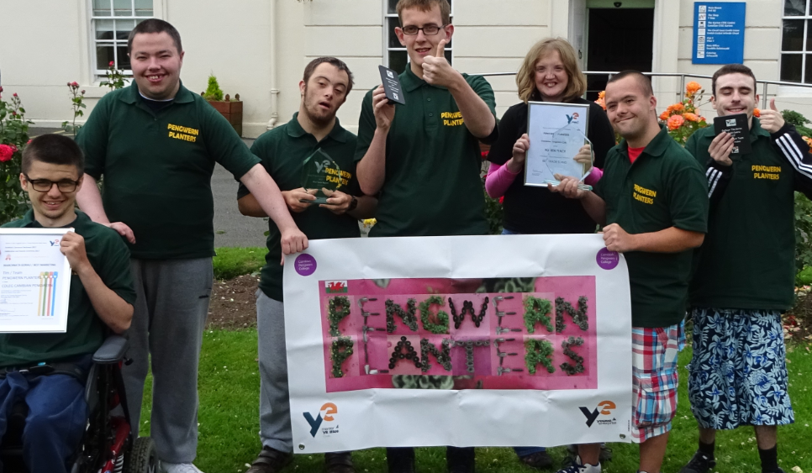
Technology gives voice to competencies
Notes:
Technology gives voice to competencies – this image is of a group of students from Pengwern College in Wales who won the ‘Best presentation’ award at the national Young Enterprise awards. The technology enabled them to showcase their skills and understanding, articulating the ‘inner dolphin’ within.

Slide 9
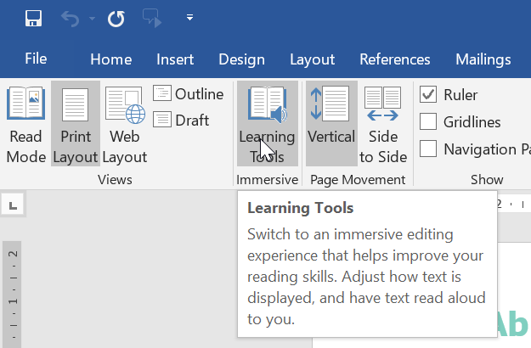
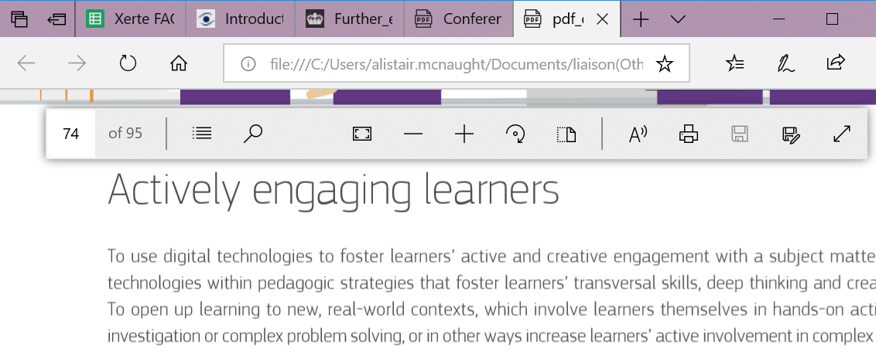
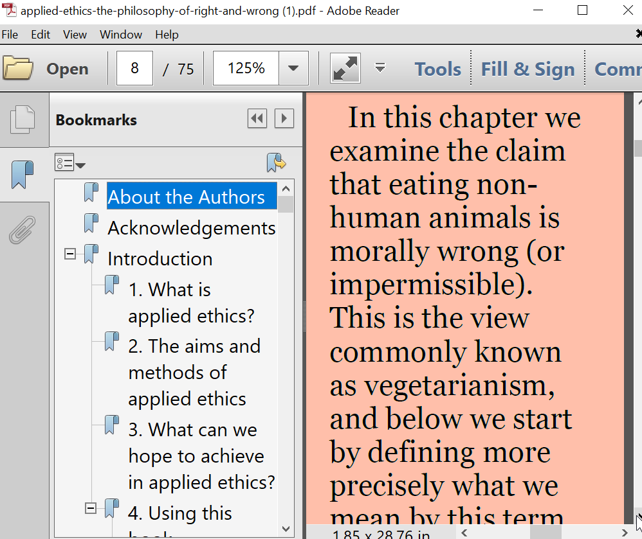
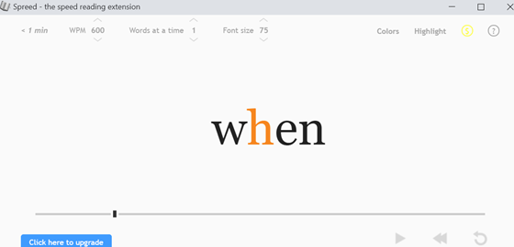
Assistive technology is everywhere - 1
Notes:
Assistive technology is everywhere – 1
But not all staff are aware of it and therefore not all students are introduced to it. The screenshots show the Learning Tools in Word (top left), built in text to speech for reading PDFs in the Edge browser (top right), navigation, magnification, reflow and colour change in Adobe Reader and text being presented a word at a time in the Spreed plugin for the Chrome browser.

Slide 10

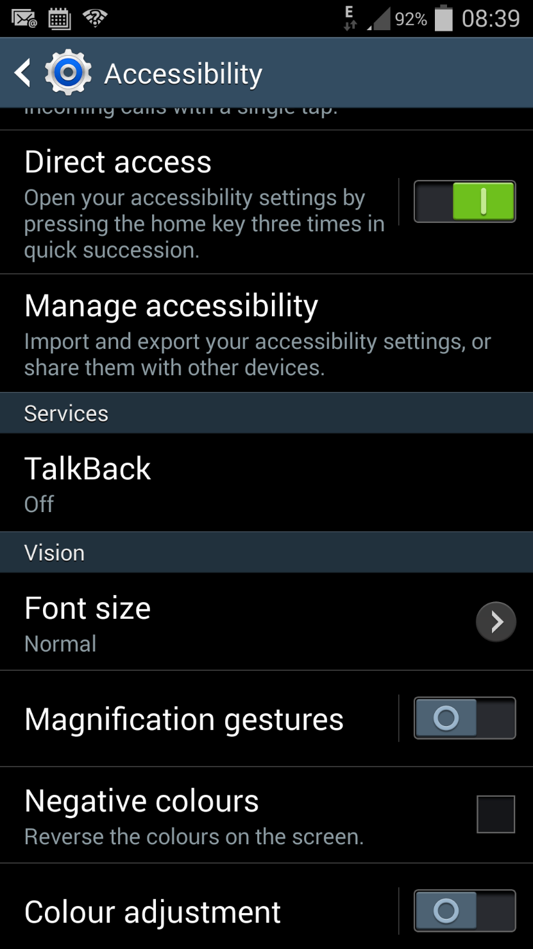
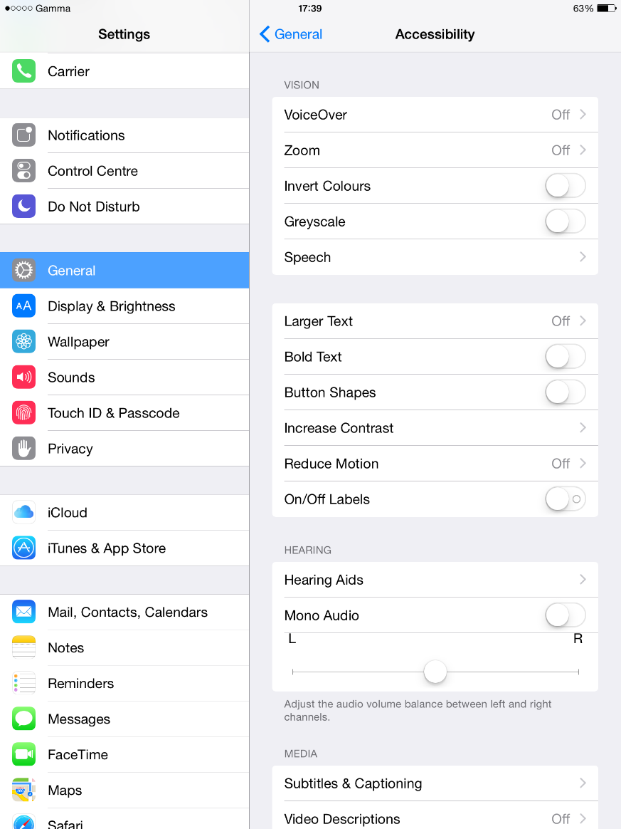




Assistive technology is everywhere -2
https://chrome.google.com/webstore
https://addons.mozilla.org/en-GB/firefox/
https://www.microsoft.com/en-gb/store/collections/edgeextensions/pc
https://safari-extensions.apple.com/
https://addons.opera.com/en/
Notes:
Assistive technology is everywhere -2
This slide shows the links to places to search for and install accessibility plugins for the Chrome, Firefox, Opera, Safari and Edge browsers. Screenshots also show the accessibility settings for Android phones and iPhones. If students know about (and use) the range of options available to them they can reduce the barriers to engaging in teaching and learning.

Slide 11
So why doesn’t everyone speak dolphinese?
Notes:
So why doesn’t everyone speak dolphinese?
Given the availability and ubiquity of assistive technology, why doesn’t everyone ‘speak dolphinese’ and provide students with the tools to articulate their skills and abilities?

Slide 12
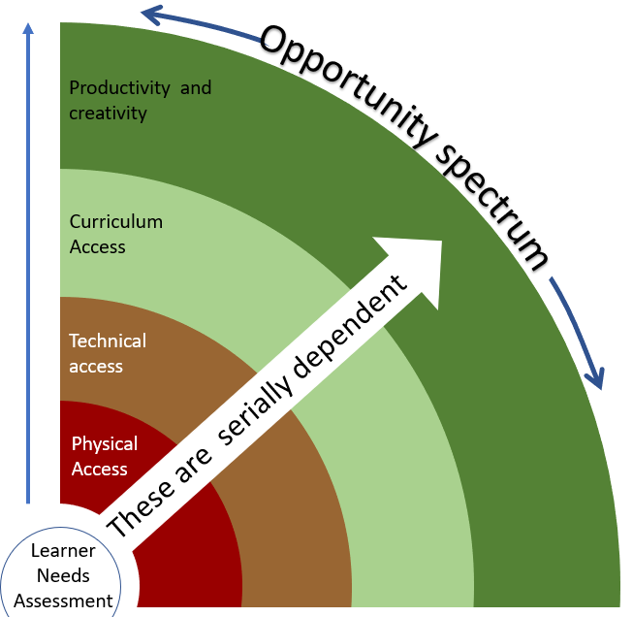
Onion priorities
Technical access
1. Access technology: learner overcomes physical limitations. Eye gaze, switches, RFID etc.
Priorities to promote independence.
Alistair McNaught - 2017
Notes:
Onion priorities
The image shows four layers of an onion round a central core. The central core is the learner’s Needs Assessment, followed by the four layers
Physical access
Technical access
Curriculum access
Productivity and creativity.
The value of each layer is dependent on the layer(s) beneath it. As you go further our the opportunities to support learners become wider.
The first layer is Access technology, where the learner uses technology to overcome physical limitations. This is about Eye gaze, switches, RFID etc

Slide 13
Onion priorities
Technical access
2. Network infrastructure: provides fast and reliable access to wider systems. Wi-Fi, learning platform, media server, security.
1. Access technology: learner overcomes physical limitations. Eye gaze, switches, RFID etc.
Priorities to promote independence.
Alistair McNaught - 2017
Notes:
Onion priorities
The image shows four layers of an onion round a central core. The central core is the learner’s Needs Assessment, followed by the four layers
Physical access
Technical access
Curriculum access
Productivity and creativity.
The Network infrastructure layer is about providing fast and reliable access to wider systems that hold digital resources or opportunities for interaction. It includes Wi-Fi, learning platform, media server, security etc.

Slide 14
Onion priorities
3. Curriculum resources online allow independent access to rich range of information, interactivity, multimedia.
Technical access
2. Network infrastructure: provides fast and reliable access to wider systems. Wi-Fi, learning platform, media server, security.
1. Access technology: learner overcomes physical limitations. Eye gaze, switches, RFID etc.
Priorities to promote independence.
Alistair McNaught - 2017
Notes:
Onion priorities
The image shows four layers of an onion round a central core. The central core is the learner’s Needs Assessment, followed by the four layers
Physical access
Technical access
Curriculum access
Productivity and creativity.
The Curriculum resources online layer allows independent access to rich range of information, interactivity, multimedia etc.

Slide 15
Onion priorities
4. Productivity (voice recognition, text to speech etc) and collaboration/creation tools facilitate autonomous learning.
3. Curriculum resources online allow independent access to rich range of information, interactivity, multimedia.
Technical access
2. Network infrastructure: provides fast and reliable access to wider systems. Wi-Fi, learning platform, media server, security.
1. Access technology: learner overcomes physical limitations. Eye gaze, switches, RFID etc.
Priorities to promote independence.
Alistair McNaught - 2017
Notes:
Onion priorities
The image shows four layers of an onion round a central core. The central core is the learner’s Needs Assessment, followed by the four layers
Physical access
Technical access
Curriculum access
Productivity and creativity.
The productivity/collaboration layer includes tools like voice recognition, text to speech etc, to help students work more independently. It also includes collaboration and creation tools to help with engagement, peer support and autonomous learning.

Slide 16
Onion people
Technical access
Skilled assessors.
People to promote independence.
Alistair McNaught - 2017
Notes:
Each onion layer has key people whose skills are needed to make the most of promoting learner independence.
The Physical access layer needs skilled assessors with a familiarity with not just commercial assistive technology but also with inbuilt tools, plugins etc.

Slide 17
Onion people
Technical access
Skilled technical staff.
Skilled assessors.
People to promote independence.
Alistair McNaught - 2017
Notes:
The technical access layer needs skilled technical staff…

Slide 18
Onion people
Digitally competent procurement.
Technical access
Skilled technical staff.
Skilled assessors.
People to promote independence.
Alistair McNaught - 2017
Notes:
The curriculum access layer needs people capable of digitally competent procurement, people who know the questions to ask to ensure purchases are accessible to your learners.

Slide 19
Onion people
Digitally competent teaching staff.
Digitally competent procurement.
Technical access
Skilled technical staff.
Physical Access
Skilled assessors.
People to promote independence.
Alistair McNaught - 2017
Notes:
Teaching staff need to extend their pedagogical skills so that they are digitally competent too, able to use the technology to ‘speak dolphinese’ and understand how it can empower their learners.

Slide 20
Onion people
Strategic senior
management (joined up policy).
Skilled assistive technologists (joined up practice).
People to promote independence.
Alistair McNaught - 2017
Notes:
Finally, ther are people who need to work across all the different levels – firstly, senior managers who can join up policy, ensuring digital investments, teaching and learning policies and staff development are properly planned and implemented and, secondly, skilled assistive technologists who can ensure that each layer of the onion can talk to the next, or troubleshoot issues when a bit of software refuses to play with a bit of hardware.

Slide 21
Underinvestment costs more
Value of investment
Value
Dabblers
Enthusiasts
Strategists
Notes:
Underinvestment costs more
The graph shows VALUE of investment and how it changes depending on whether you
dabble with technology (which can result in poor, variable or negative value added)
Have staff enthusiasts who have a broad commitment to using technology to empower students or
Have a strategic approach driven from the top that ensures technology use is embedded, rather than vulnerably dependent on one or two enthusiasts who might leave.

Slide 22
Underinvestment costs more
Value of investment
Inappropriate use
Inefficient use
Cost of investment
Unsustainable use
Cost
Dabblers
Enthusiasts
Strategists
Notes:
This is the same graph with costs superimposed. Costs rise as you move from dabblers to enthusiasts to strategists but the value obtained from those costs rises much faster. This is why underinvestment is more expensive – it provides much smaller return on investment so the value added is smaller and less predictable.

Slide 23
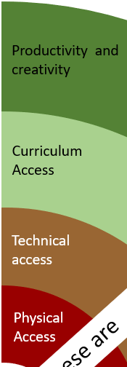
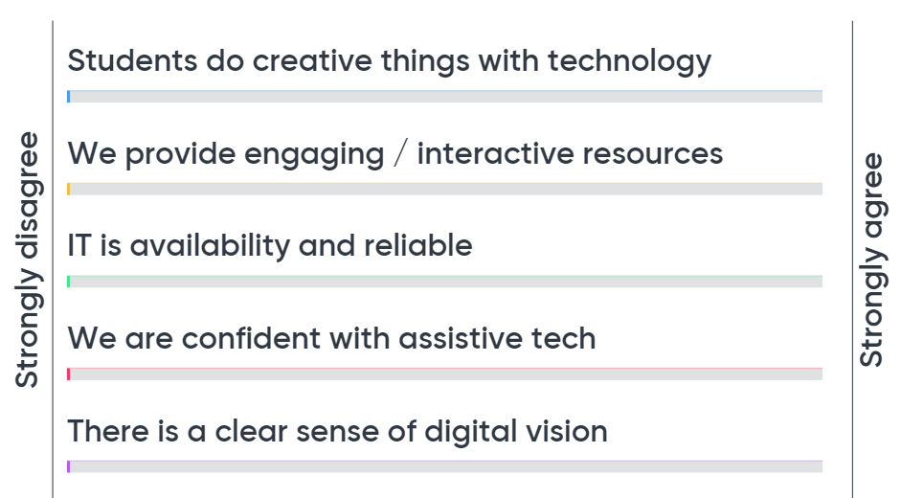
Plotting your strengths and weaknesses
www.menti.com and use the code 41 30 98
Notes:
Plotting your strengths and weaknesses
This was a mentimeter activity, allowing people to compare their strengths and weaknesses with those of others. The scales went from strongly disagree to strongly agree and the statements that people assesses themselves against were:
Students do creative things with technology
We provide engaging / interactive resources
IT is availability and reliable
We are confident with assistive tech
There is a clear sense of digital vision

Slide 24
Peeling back the onion…
What learners use | Why they use it | What or how
Images | Personal, simplicity, archivable, metadata (date, place, tages etc) | Camera, phone, Google photos, Keynote, Apps (Thinglink etc).
Audio | As above. | Phone, software tools (eg Audacity), hardware recorder, PowerPoint.
Screen capture | Describe images, artefacts etc. | Powerpoint, screencastomatic etc
Video clips | Demonstrate agency, creative, technical & communication skills. | Mobile phone, tablet, webcam, video camera.
Text to speech | Independence. Age appropriate. | Word. Browsers. Apps. Commercial.
Voice recognition | Independence, productivity. | Google voice typing, Siri, Microsoft dictate, VoiceNote2 chrome plugin, commercial.
Notes:
Peeling back the onion…
At the outer level of the onion – productivity and creativity – you can consider what learners use (eg images, audio, screen capture, video etc), why they use it (what are the pedagogical or accessibility advantages?) and what tools (software, hardware etc) are used.
Images because of personalness, simplicity, archivable, metadata (date, place, tages etc). They can be captured with Camera, phone, Google photos, Keynote, Apps (Thinglink etc).
Audio has similar benefits to images and can be captures with learner’s own Phone, software tools (eg Audacity), hardware recorder, PowerPoint etc.
Screen capture can describe images, artefacts etc and be captured on Powerpoint, screencastomatic etc.
Video clips can demonstrate agency, creative, technical & communication skills and can be captured on Mobile phone, tablet, webcam, video camera.
Text to speech provides independence and gives access to more age appropriate materials. It is available via Word, Browsers, Apps and Commercial offerings.
Voice recognition can provide independence and productivity. It includes tools like Google voice typing, Siri, Microsoft dictate, VoiceNote2 chrome plugin, commercial.

Slide 25
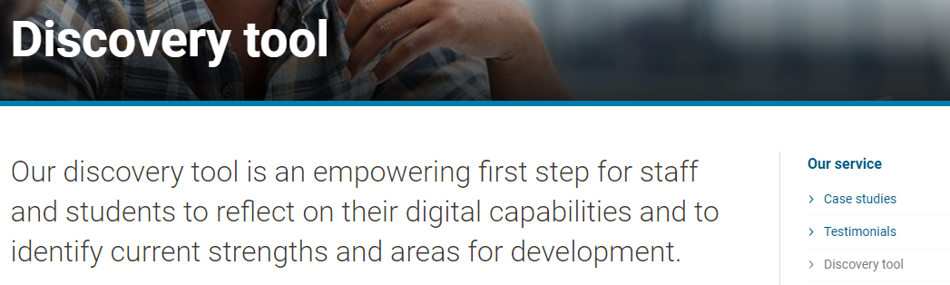
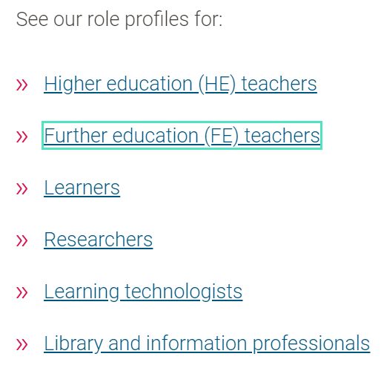
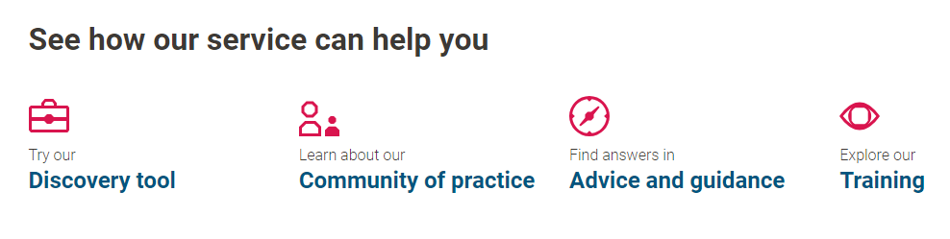
Jisc support for digital capability
Jisc VLE review
https://digitalcapability.jisc.ac.uk/our-service/discovery-tool/
https://digitalcapability.jisc.ac.uk/
https://digitalcapability.jisc.ac.uk/what-is-digital-capability/
Notes:
Jisc supports organisations with their staff development – for example Jisc’s digital capability service https://digitalcapability.jisc.ac.uk/
includes a discovery tool (https://digitalcapability.jisc.ac.uk/our-service/discovery-tool/) as well as review services like our VLE review or infrastructure review.

Slide 26
Resources & curriculum
NatSpec crowdsourced?
Age appropriate reading resources at one end of the spectrum
Training and preparation for HE level IT systems (eg VLEs, Ebooks) and other.
RNIB collections - https://www.rnibbookshare.org/cms/
Jisc Ebooks for FE - https://www.jisc.ac.uk/e-books-for-fe
Project Gutenberg - http://www.gutenberg.org/
YouTube – www.youtube.com
VideoJug - http://www.videojug.com/
Librivox - https://librivox.org/
https://ec.europa.eu/jrc/en/digcompedu
Notes:
The resources and curriculum layer of the onion can come from many places including:
NatSpec crowdsourced?
Age appropriate reading resources at one end of the spectrum
Training and preparation for HE level IT systems (eg VLEs, Ebooks) at other.
RNIB collections - https://www.rnibbookshare.org/cms/
Jisc Ebooks for FE - https://www.jisc.ac.uk/e-books-for-fe
Project Gutenberg - http://www.gutenberg.org/
YouTube – www.youtube.com
VideoJug - http://www.videojug.com/
Librivox - https://librivox.org/

Slide 27
Technical infrastructure and accessibility
Techability
Jisc infrastructure review
Jisc digital strategy review
Google accessibility – https://tiny.cc/googleacc
Microsoft accessibility
Apple accessibility
Notes:
Technical infrastructure and accessibility
Support at this layer of the onion can be found through:
Techability
Jisc infrastructure review
Jisc digital strategy review
Google accessibility – https://tiny.cc/googleacc
Microsoft accessibility
Apple accessibility

Slide 28
Assistive and access technology
Techability
BATA
Karten network
https://ec.europa.eu/jrc/en/digcompedu
Notes:
The Physical Access layer of the onion relates mainly to assistive and access technology where the following can support:
Techability
BATA
Karten network

Slide 29
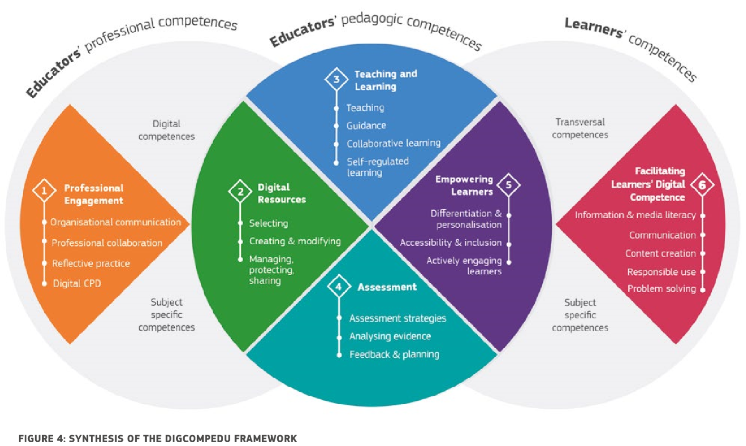
Going further?
https://ec.europa.eu/jrc/en/digcompedu
Notes:
Going further?
For further staff development opportunities see the DigCompEdu framework for teaching and learning https://ec.europa.eu/jrc/en/digcompedu
– it is an excellent framework that takes account of accessibility and inclusion as well as learner’s own skills. The FutureTeacher project has webinars and online resources mapped to this framework.

Slide 30
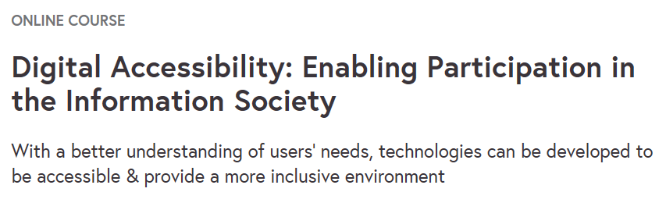
Going further?
https://www.futurelearn.com/courses/digital-accessibility
Notes:
Going further?
See the FutureLearn course Digtial Accessibility – enabling participation in the Information society https://www.futurelearn.com/courses/digital-accessibility

Slide 31
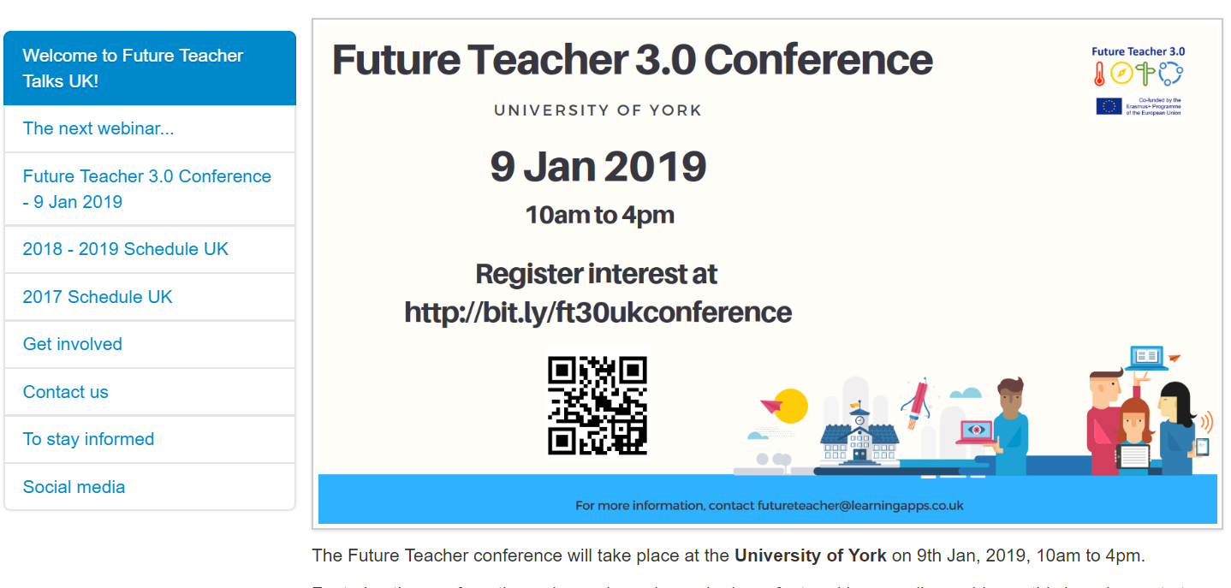
Going further?
https://xot.futureteacher.eu/play.php?template_id=4
Notes:
Going further?
See the FutureTeacher programme – free webinars and online resources and training modules that can be adapted by your institution.
https://xot.futureteacher.eu/play.php?template_id=4

Slide 32

Find out more…
Alistair McNaught Subject specialist (accessibility and inclusion)
Alistair.mcnaught@jisc.ac.uk
jisc.ac.uk
Except where otherwise noted, this work is licensed under CC-BY-NC-ND
Notes:
Contact
Alistair McNaught Subject specialist (accessibility and inclusion)
Alistair.mcnaught@jisc.ac.uk
jisc.ac.uk

