Slide 1


Make Echo and Google Home Work for You
Fil McIntyre – Lead Assistive Technologist, Beaumont College
Paul Doyle – Access Centre Manager, Hereward College
Notes:
Make Echo and Google Home Work for You
Fil McIntyre – Lead Assistive Technologist, Beaumont College
Paul Doyle – Access Centre Manager, Hereward College

Slide 2
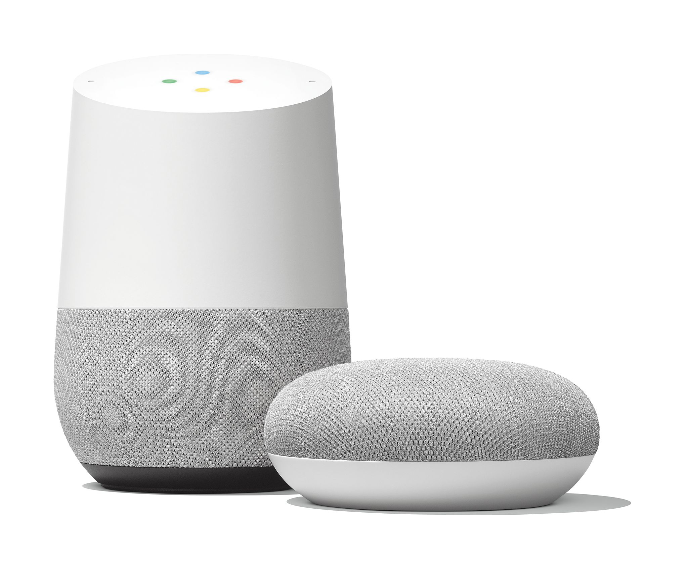
What can this thing do?
Notes:
Image of Google Home and Google Home mini.
Text – “What can this thing do?”
Devices can respond to queries and questions which can be found on web.
Get much more powerful when coupled with home control technologies to activate lights, fans etc.

Slide 3
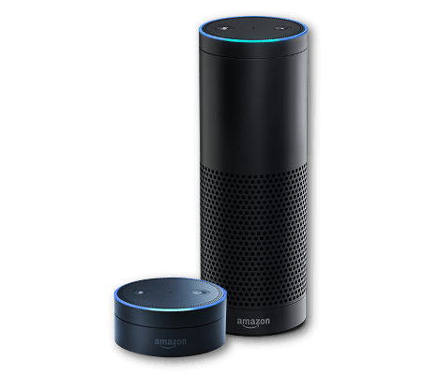
Convenience
Access
Notes:
Images of Amazon Echo and Echo Dot, Google Home and Google Home mini
Text reads “Convenience”
Text reads “Access”
Devices such as these are created to be convenient for most consumers e.g. don’t need to wash hands to turn on music when cooking. However they can be transformative for someone who finds mp3 player too fiddly or can’t use their hands to turn on a lamp.

Slide 4
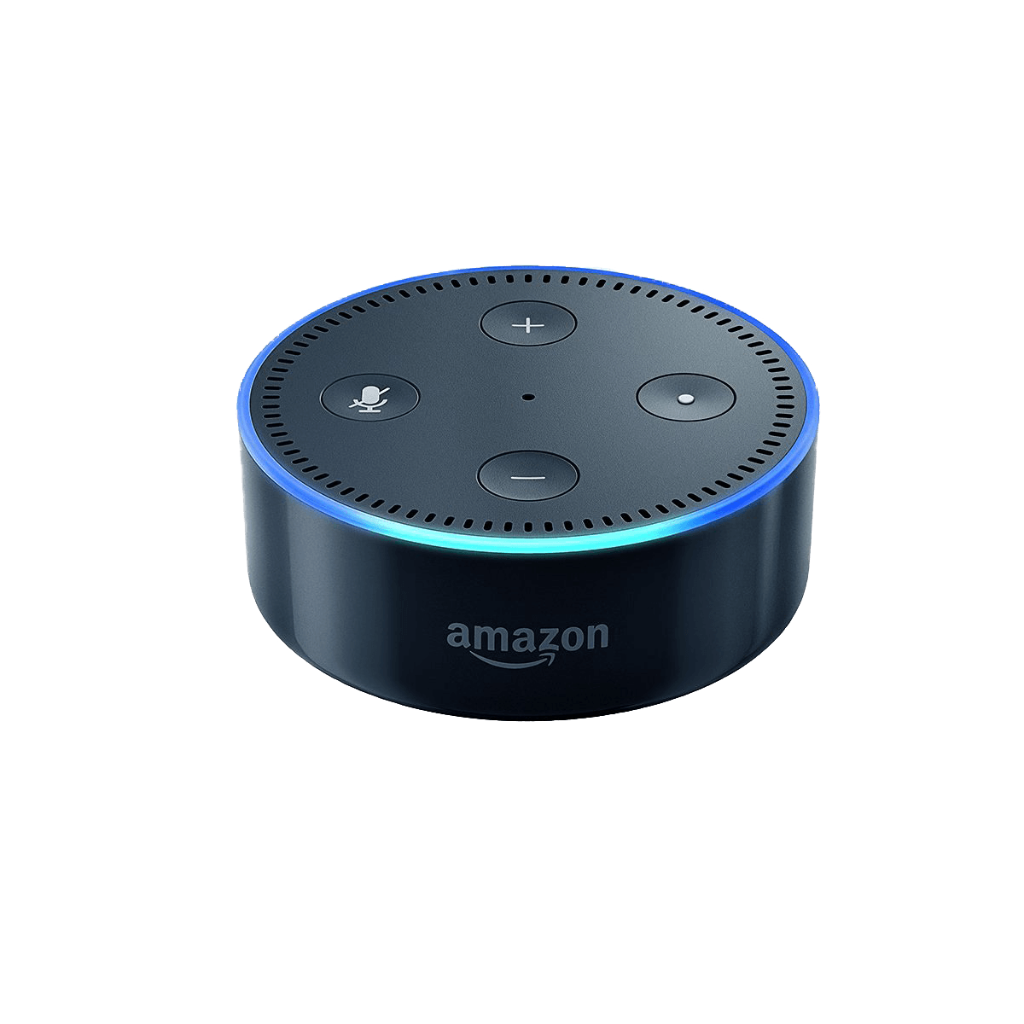
Beaumont College Experience 1
2 Learners – residential
Echo dot set up in bedroom
Linked to music library
Linked to one remote plug
Notes:
Beaumont College Experience 1
Bullet points:
2 Learners – residential
Echo dot set up in bedroom
Linked to music library
Linked to one remote plug

Slide 5
Positives
Easy access to music –
no buttons to fiddle with
Easy access to lamp –
no switches to fiddle with
Easy access to information –
no keyboard/touchscreen to fiddle with
Notes:
Positives
Easy access to music –
no buttons to fiddle with
Easy access to lamp –
no switches to fiddle with
Easy access to information –
no keyboard/touchscreen to fiddle with

Slide 6
Challenges
Don’t be too polite!
Pronunciation is critical
Workarounds are possible “lamp” vs. “ramp”
Wi-Fi in college setting can be tricky
Ports
Google home on same network
Notes:
Challenges
Don’t be too polite!
Pronunciation is critical
Workarounds are possible “lamp” vs. “ramp”
Wi-Fi in college setting can be tricky
Ports
Google home on same network

Slide 7
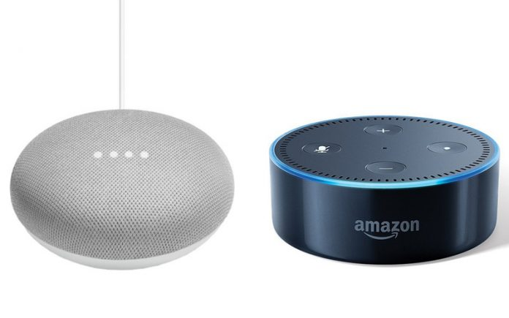
Beaumont College Experience 2
Multiple Learners
Mix of verbal & AAC users
Testing Echo and Google Home
Both in Assessment Room
Google Home in Student Common Room with Google Chrome
Notes:
Beaumont College Experience 2
Bullet points:
Multiple Learners
Mix of verbal & AAC users
Testing Echo and Google Home
Both in Assessment Room
Google Home in Student Common Room with Google Chrome

Slide 8
Positives
Instantly engaging and powerful: “Echo play Thomas videos on office TV”
Works for AAC users – sometimes better as AAC output consistent
Notes:
Image of Google Home Mini and Echo Dot
Positives:
Instantly engaging and powerful: “Echo play Thomas videos on office TV”
Works for AAC users – sometimes better as AAC output consistent

Slide 9
Challenges as before plus…
Wake word not always possible – Alexa, Echo, Computer, Hey Google, OK Google
If pause too long tech loses interest!
Google Home War: “hey google play Taylor Swift”, “hey google play the Lancashire hotpots” etc…
Notes:
Image of Google Home Mini and Echo Dot
Challenges as before plus:
Bullet points:
Wake word not always possible – Alexa, Echo, Computer, Hey Google, OK Google
If pause too long tech loses interest!
Google Home War: “hey google play Taylor Swift”, “hey google play the Lancashire hotpots” etc…

Slide 10
Voice assistants at Hereward College
Trials and Tribulations
Notes:
Voice assistants at Hereward College
Trials and Tribulations

Slide 11
Alexa in the Learning Resource Centre
Inherent mistrust of voice tech across the college population
Competition between Alexa and PC based search engine!
10 questions set to determine who was fastest on the draw!
Questions ranged from who is the prime minister of the UK? to how do you spell rhythm?
Notes:
Alexa in the Learning Resource Centre
Bullet Points:
Inherent mistrust of voice tech across the college population
Competition between Alexa and PC based search engine!
10 questions set to determine who was fastest on the draw!
Questions ranged from who is the prime minister of the UK? to how do you spell rhythm?

Slide 12
Alexa in the Learning Resource Centre
Pros
No keyboarding skills required
Speed
Consistent response was seen as a bonus by some
Cons
Initiating command can be a problem (alex, alisha, aleexa)
Some struggled to formulate questions and became frustrated
Some did not remember the system rule “what’s the time Alexa”
Results are is transitory
Notes:
Alexa in the Learning Resource Centre
Pros
No keyboarding skills required
Speed
Consistent response was seen as a bonus by some
Cons
Initiating command can be a problem (alex, alisha, aleexa)
Some struggled to formulate questions and became frustrated
Some did not remember the system rule “what’s the time Alexa”
Results are is transitory

Slide 13
Alexa in the Learning Resource Centre
Conclusions
We found there was no clear winner. Horses for courses
Alexa can promote communication and confidence (aspergers)
Voice assistants help to scaffold social skills (True of False game)
Alexa and Goggle Home are useful staff awareness raising tools
Always use their name at the beginning so that they know you are talking to them
Make sure they are paying attention before you ask a question or give an instruction. The signs that someone is paying attention will be different for different people
Notes:
Alexa in the Learning Resource Centre
Conclusions
We found there was no clear winner. Horses for courses
Alexa can promote communication and confidence (aspergers)
Voice assistants help to scaffold social skills (True of False game)
Alexa and Goggle Home are useful staff awareness raising tools
Always use their name at the beginning so that they know you are talking to them
Make sure they are paying attention before you ask a question or give an instruction. The signs that someone is paying attention will be different for different people

Slide 14
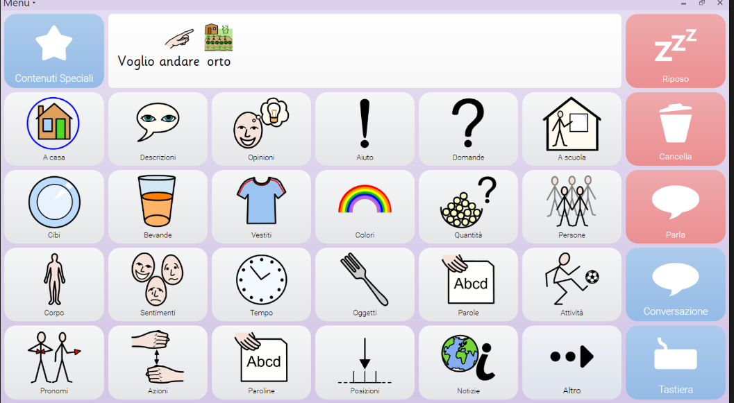
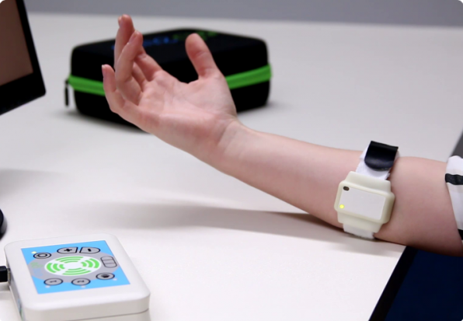
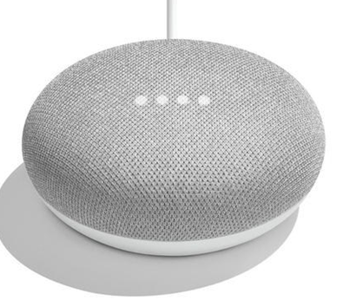
Alexa in the College
Notes:
Alexa in the College
Image of communication grid from AAC devices
Image of Emego switch attached to users arm
Image of Google home mini
Google Home was used in combination with communication device to engage a Hereward Learner and motivate him to use his Emego switch. He was previously unengaed with just voice output.

Slide 15
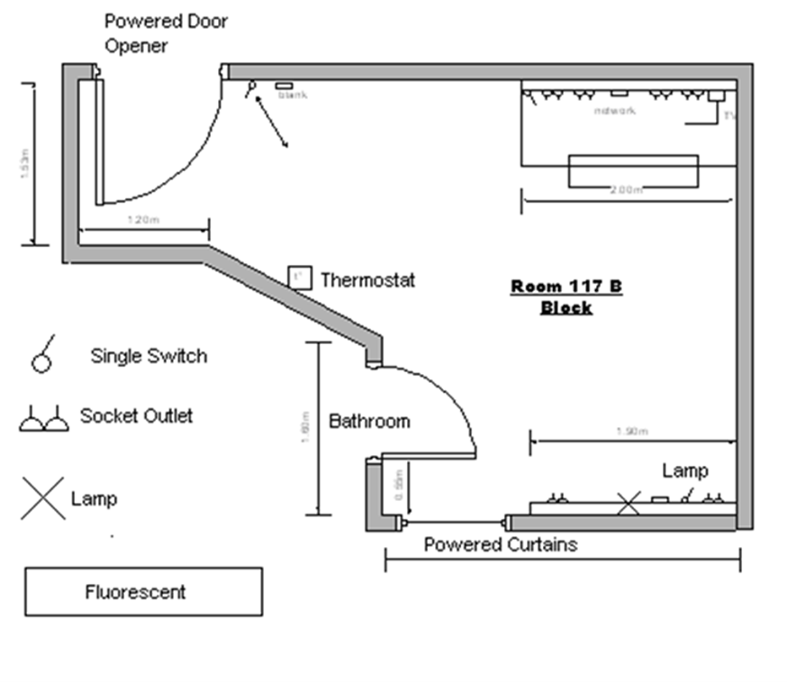
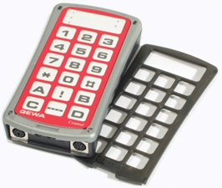
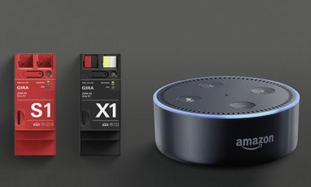
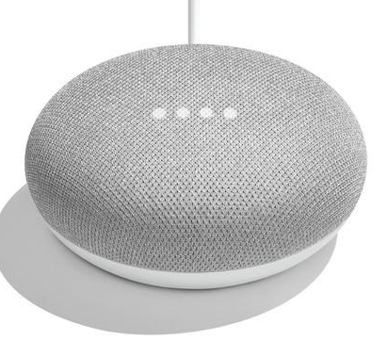

Voice assistants in the Future
Notes:
Voice assistants in the Future
Schematic image of room with environmental controsl such as light switches, sockets and lamp marked.
Image of KNX controllers and Gewa Infra-Red controller
Hereward college are looking at integrating voice activated devices with home control technology.
Cannot be relied on for critical support such as emergency calls

Slide 16
Make Echo and Google Home Work for You
Fil McIntyre – fil.mcintyre@beaumontcollege.ac.uk
Paul Doyle – paul.doyle@hereward.ac.uk
Notes:
Make Echo and Google Home Work for You
Fil McIntyre – fil.mcintyre@beaumontcollege.ac.uk
Paul Doyle – paul.doyle@hereward.ac.uk

